Slide 1
The Exploration of Overholt Cave 1956 - 1961
An NSS Audio-Visual
Library Presentation
Pittsburgh Grotto (1963)
S706 70 Slides 1/23/2021

Slide 2
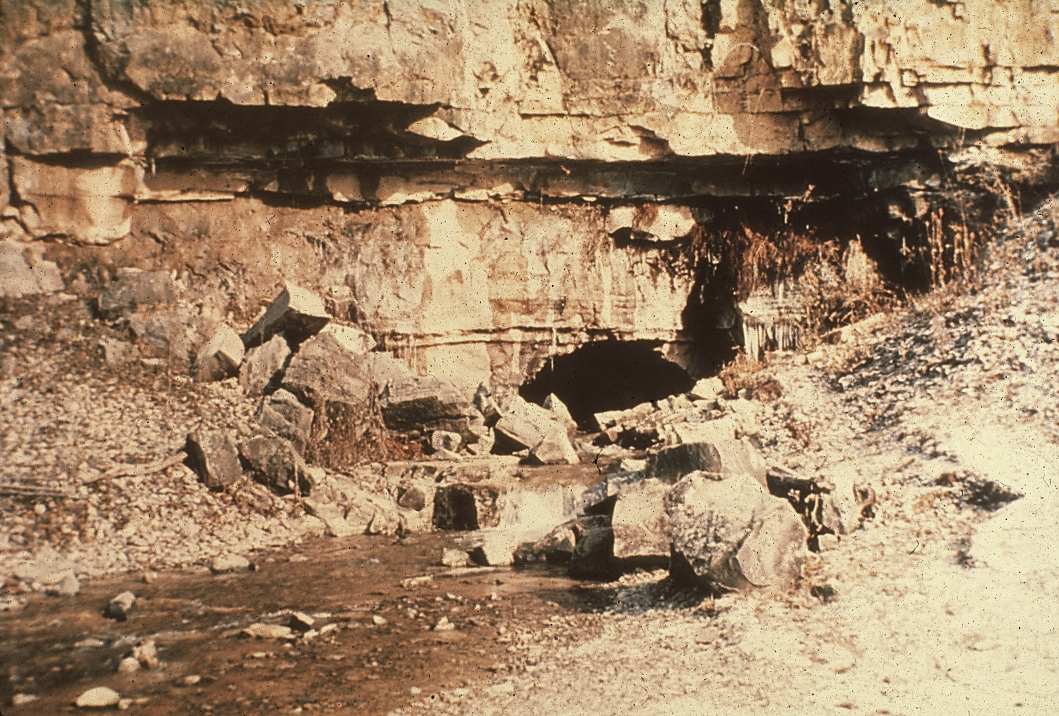
Notes:
Very few of the caves that lie in the Appalachian Mountains are of such a nature that several days are necessary to reach its end. This is the story of the exploration of such a cave.
The entrance to Overholt Blowing Cave has been know and used as a water source, ever since the Swago Valley in West Virginia was first settled. But it was not until 1956 that three members of the Pittsburgh Grotto splash through the stream in the entrance crawl and begin the exploration of Overholt Blowing Cave.

Slide 3
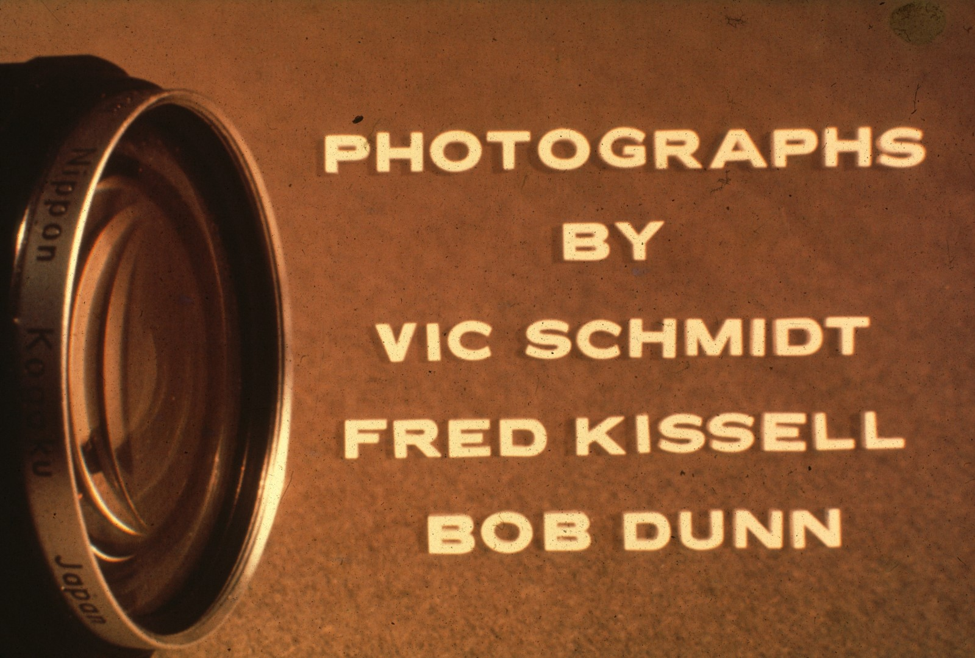
Notes:
The photographs in this series were taken over a period of the years 1959 to 1963. Some were taken during initial explorations, while others were taken on special photographic trips.

Slide 5
Notes:
The Pittsburgh Grotto wishes to dedicate this slide series to Mr. G. D. McKeever, a resident of the Swago Valley in which Overholt is located, and a truly wonderful friend of the Grotto, ever since it first began work in the area. His interest, assistance, enthusiasm, and thirst for knowledge about the caves that lie so abundantly about his home, have been invaluable in making possible a though study of the Swago Creek area.

Slide 6
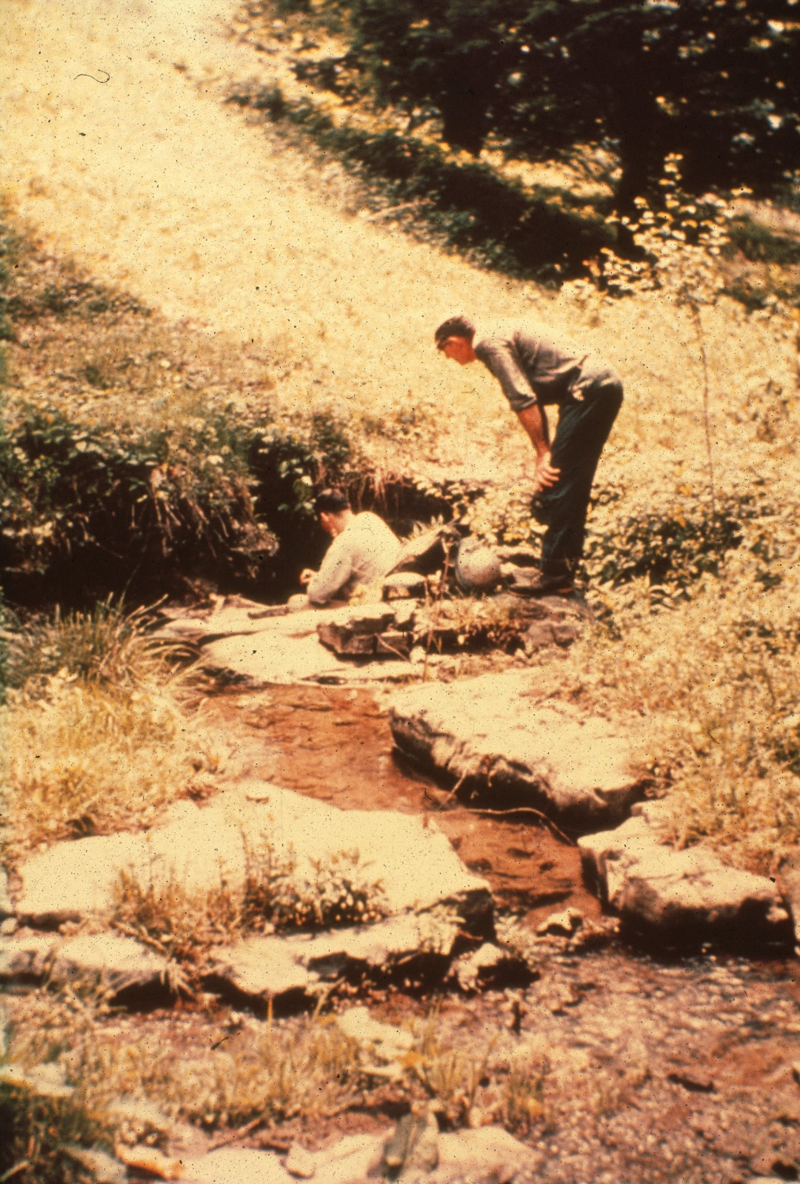
Notes:
The entrance to Overholt Blowing Cave is not at all imposing. Less than five feet high, the entrance in summer emits a blast of cold air that has given the cave its name. And discharges a stream that forms the headwaters of Swago Creek.

Slide 7
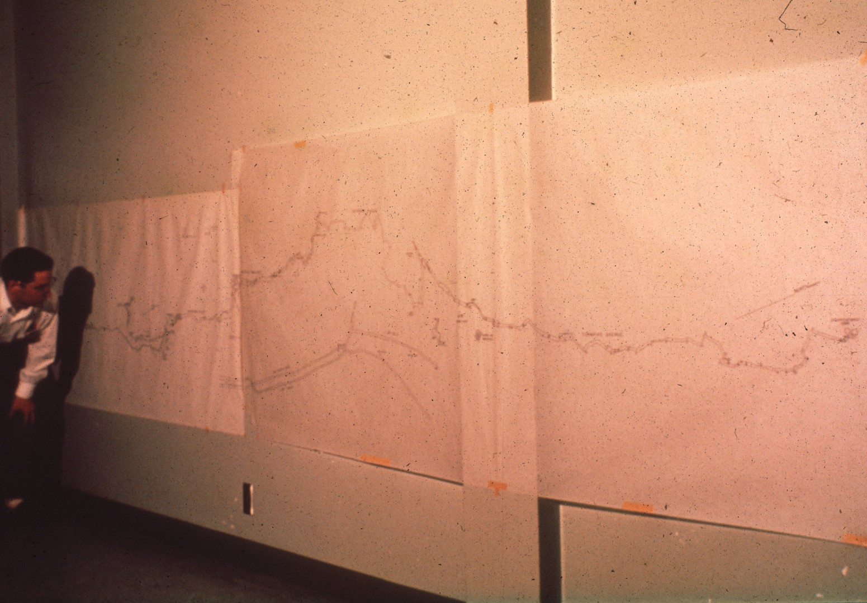
Notes:
But this small entrance says nothing of what lies beyond. This map of the cave, still incomplete, stretches for seventeen feet, at a scale of fifty feet to the inch. Nearly three mile of passage must be traversed in order to reach the currently known end of the cave. This, and the presence of a series of waterfalls that must be climbed from the bottom, have made extended exploration trips of two to four days duration necessary.

Slide 8
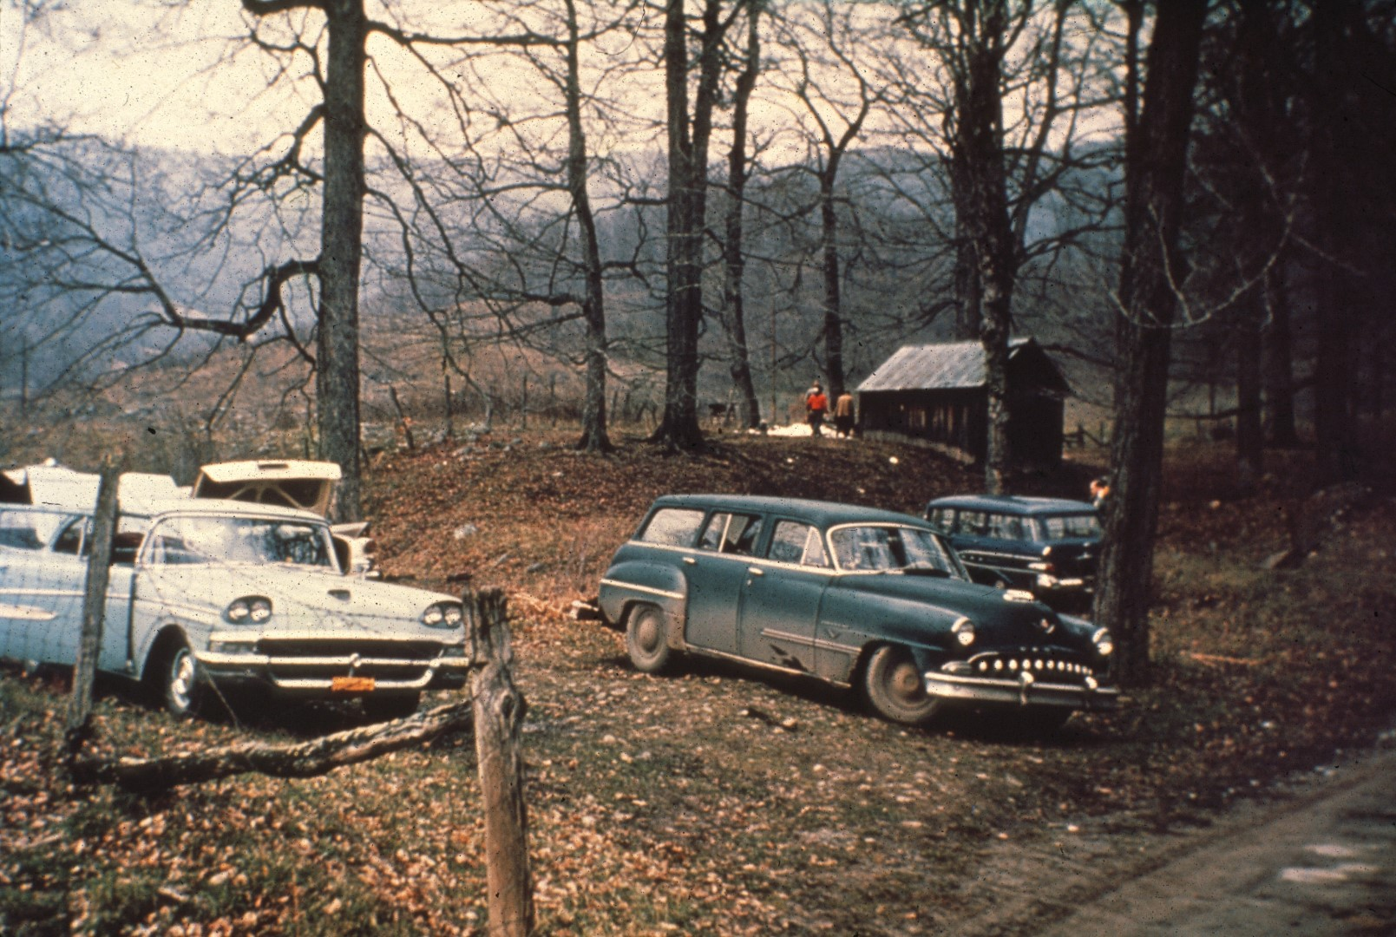
Notes:
On such a trip to the know limits of the system, cars begin arriving from Pittsburgh late at night, at an abandoned sugar curing shed that Mr. McKeever has provided for our use. Early in the morning, somebody manages to get up, and gleefully pulls the plugs on all the air mattresses.

Slide 9
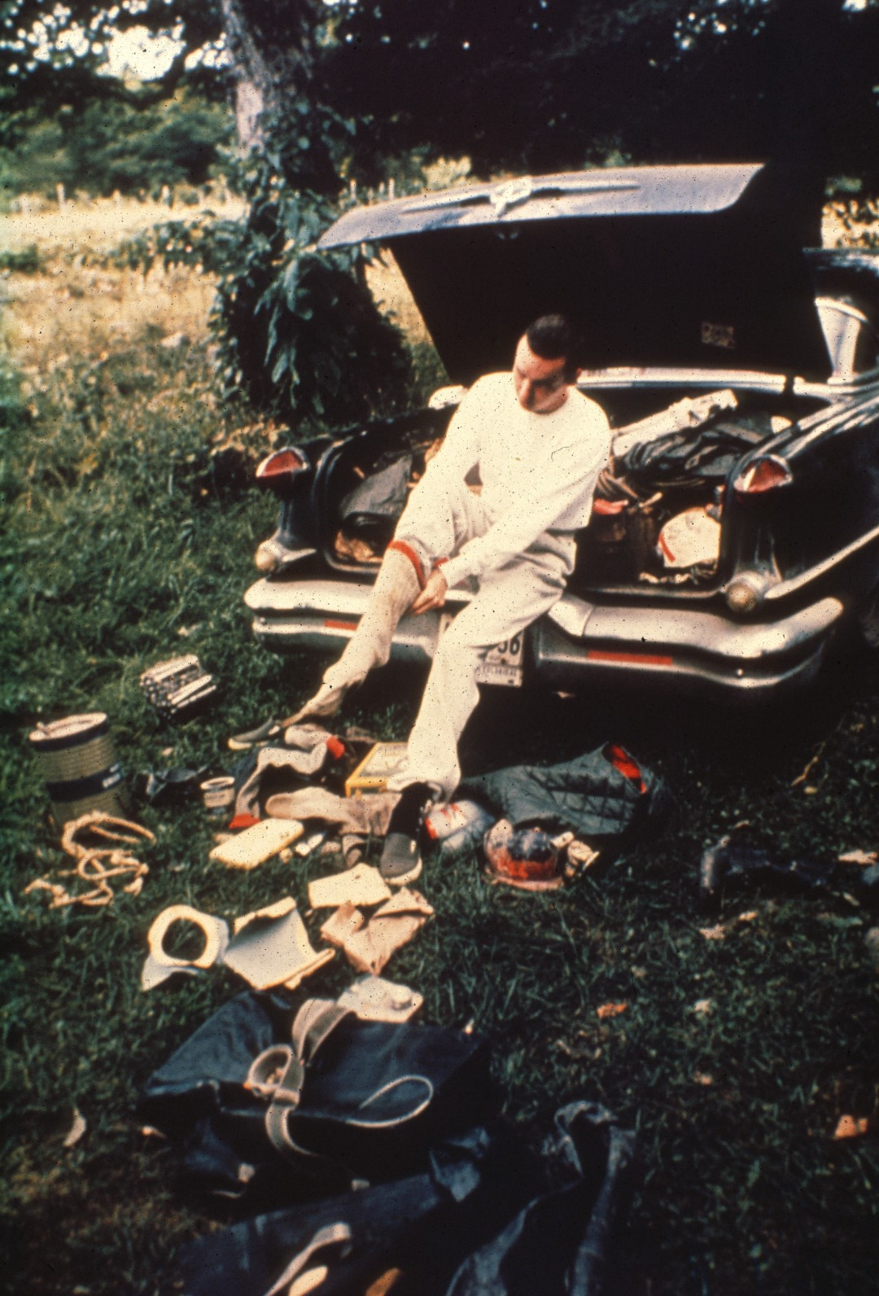
Notes:
It’s time to get dressed and gather together the vast piles of gear and supplies that must be carried into the cave. Air and water in Overholt are notoriously cold, generally from 47 to 49 degrees. And several layers of heavy underwear will help Sill Plummer, visiting from the Baltimore Grotto, to stay comfortable during the long hours underground.

Slide 10
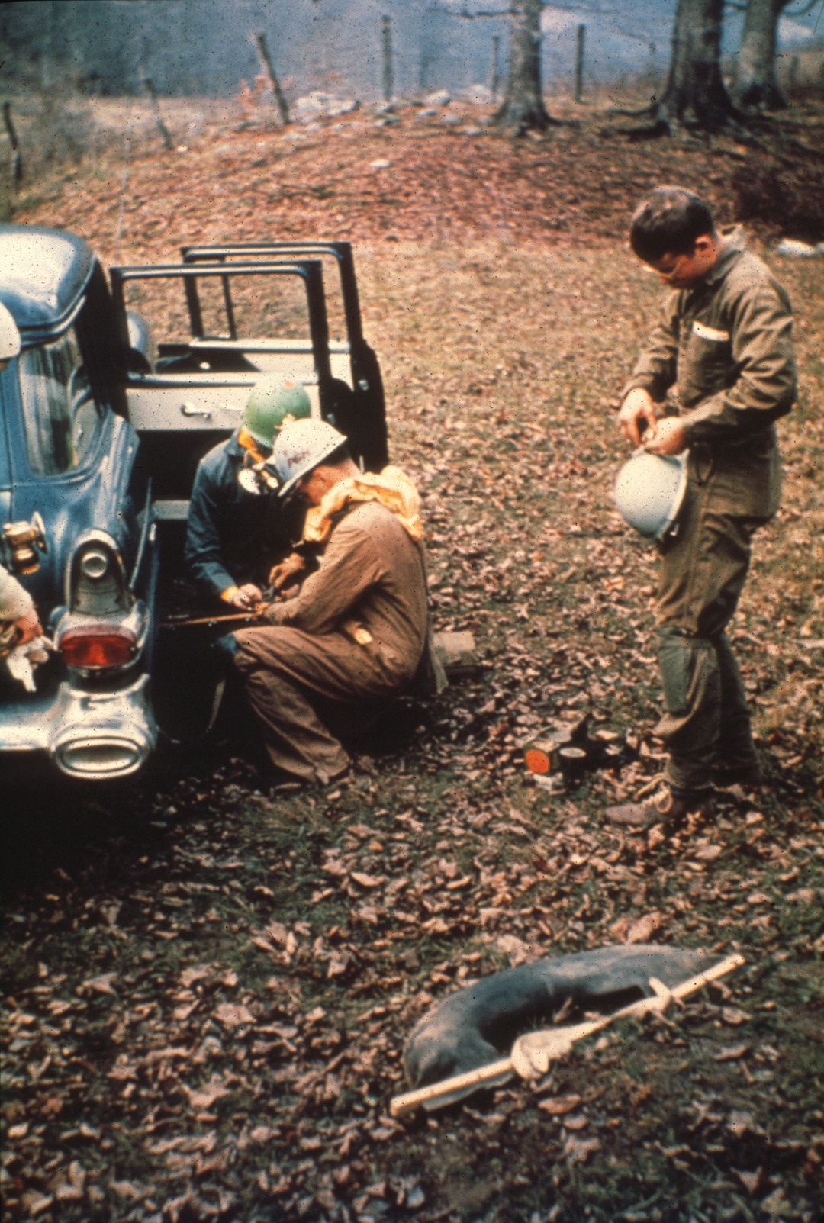
Notes:
Supplies are sealed in old truck innertubes to protect them from the water. Quickly dubbed "Baloneys", these improvised packs have proved to be extremely rugged, unsinkable, and can be snaked through muddy crawl ways with a minimum of effort.

Slide 11
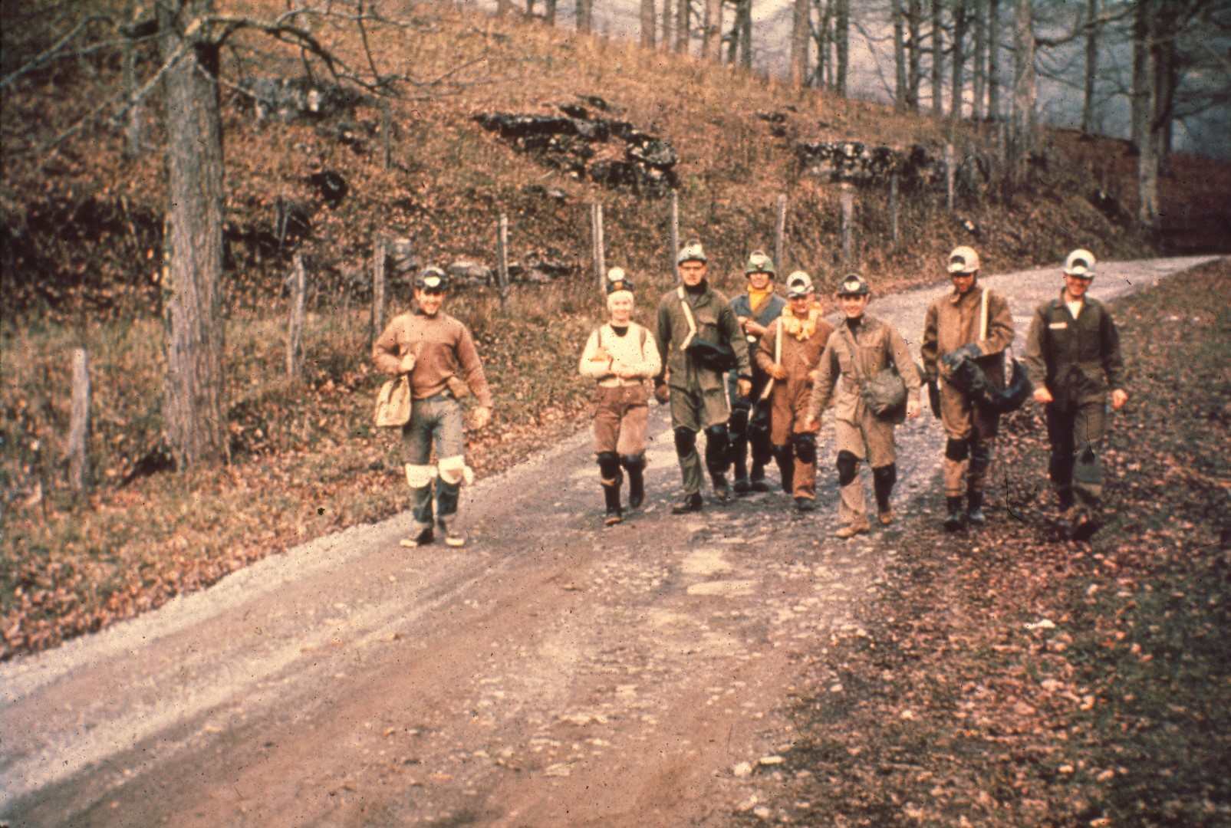
Notes:
The expedition of longer duration has generally required a supplementary supply trip. Usually made several weeks earlier than the main push. Here during the 1959 Thanksgiving Holiday, the supply party makes its way to the cave. These supplies were hauled into the first two miles of the cave and left at the base of the second waterfall. Two months later the first major expedition was launched with plans to spend a total of three days underground.

Slide 12
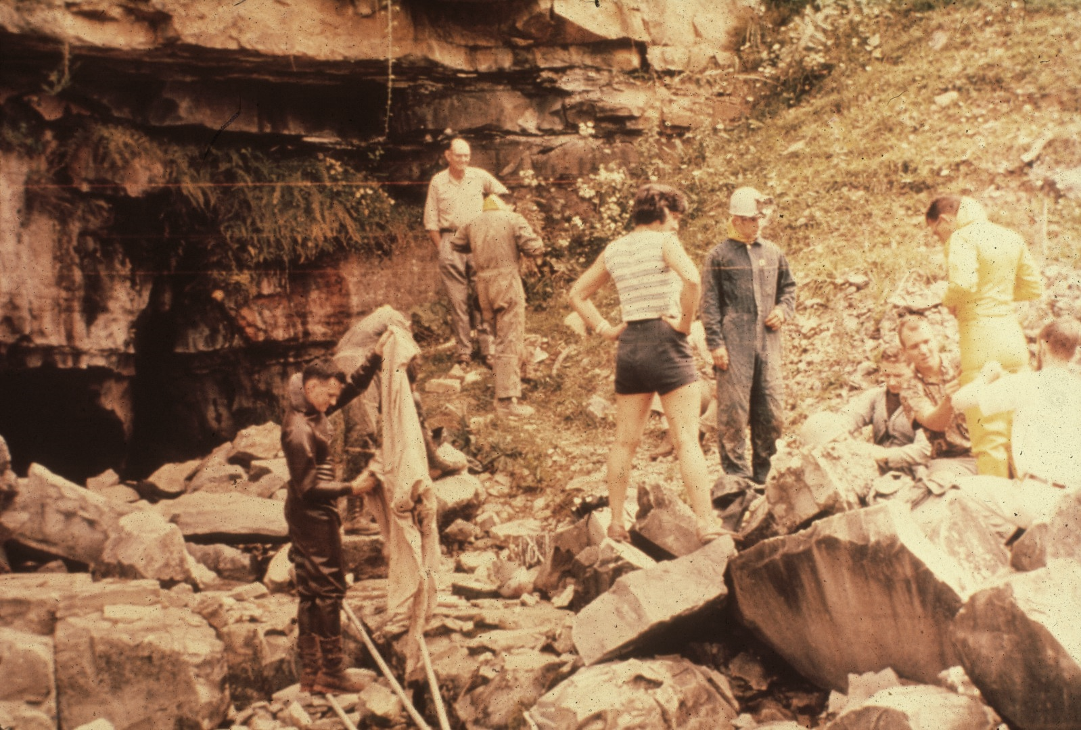
Notes:
Though early explorations of Overholt were made in standard caving gear, perhaps reinforced with an extra pair of long woolies, explorations from 1959 on came to rely heavily on the use of watertight skindiver's dry suits. The extremely wet nature of the cave quickly took their use out of the realm of luxury, and they are now considered to be necessary for a successful extended trip into Overholt. In fact, with their use the most uncomfortable part of the trip seems to be the act of getting into them. For example, here are . . .

Slide 13
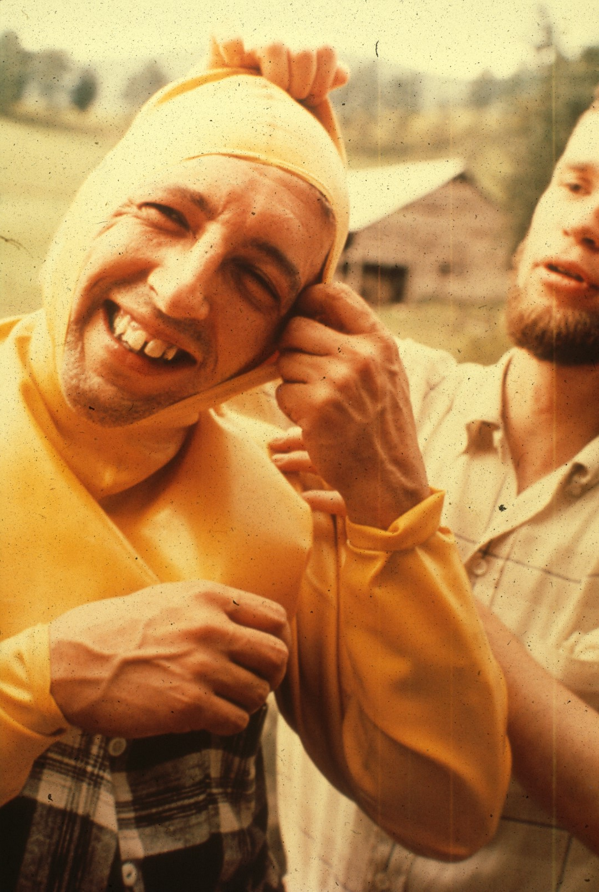
Notes:
Jack Stellmack,

Slide 14
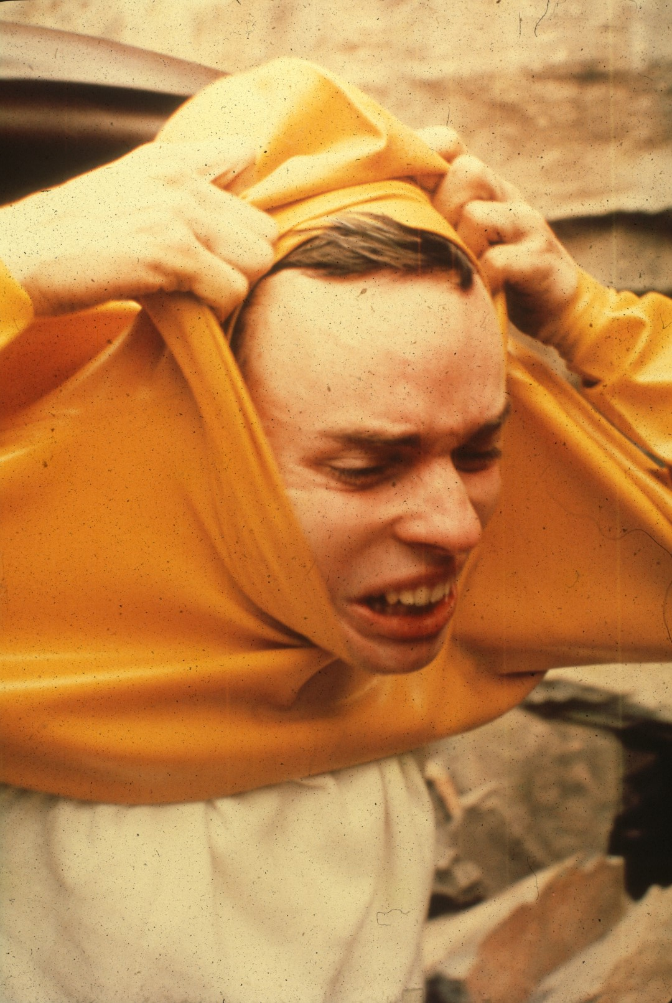
Notes:
Bill Plummer,

Slide 15
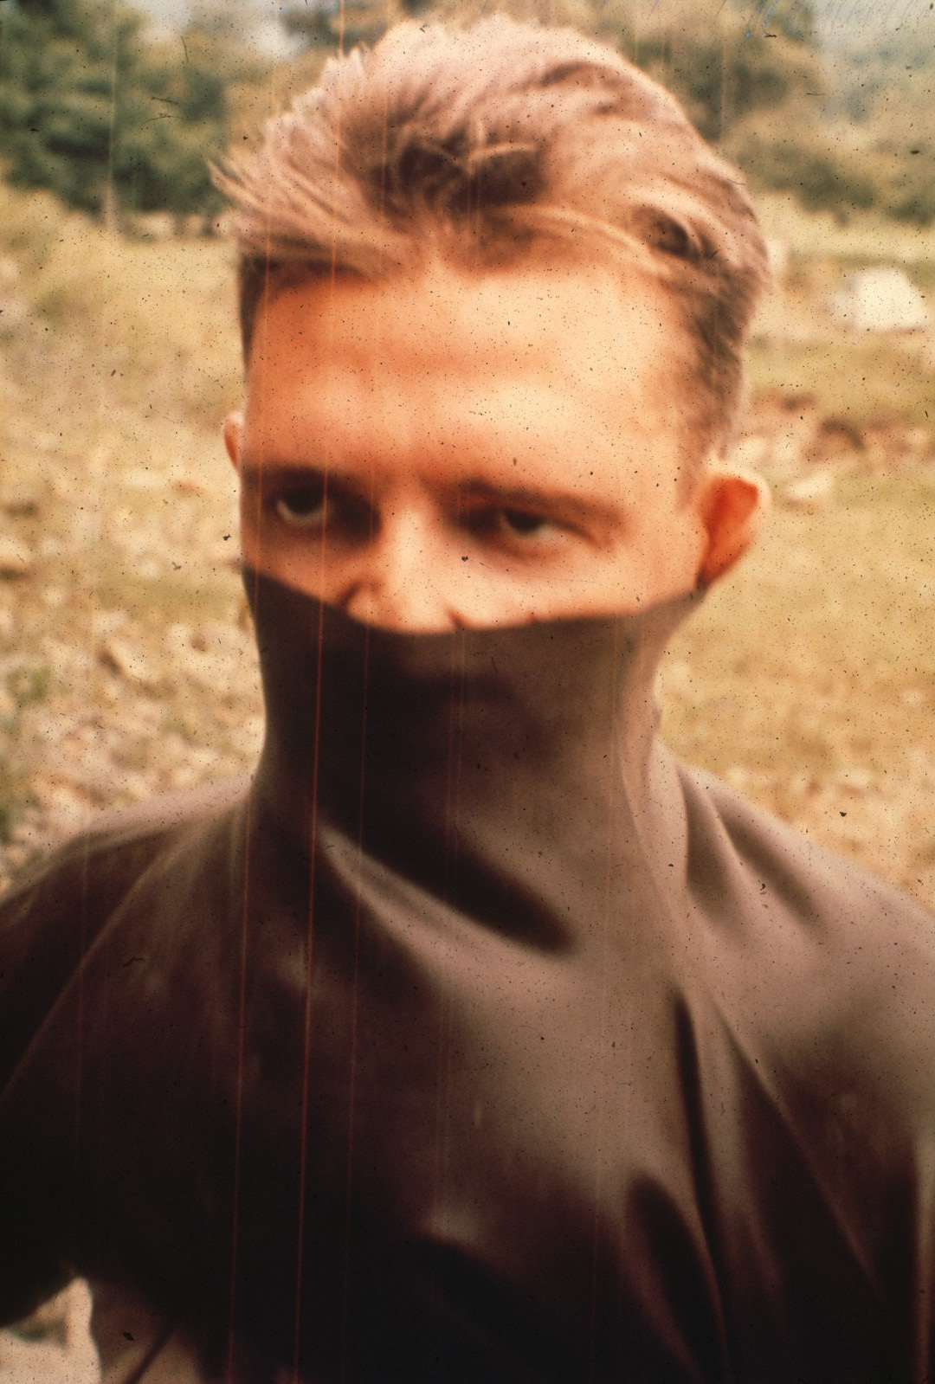
Notes:
and Vic Schmitt.

Slide 16
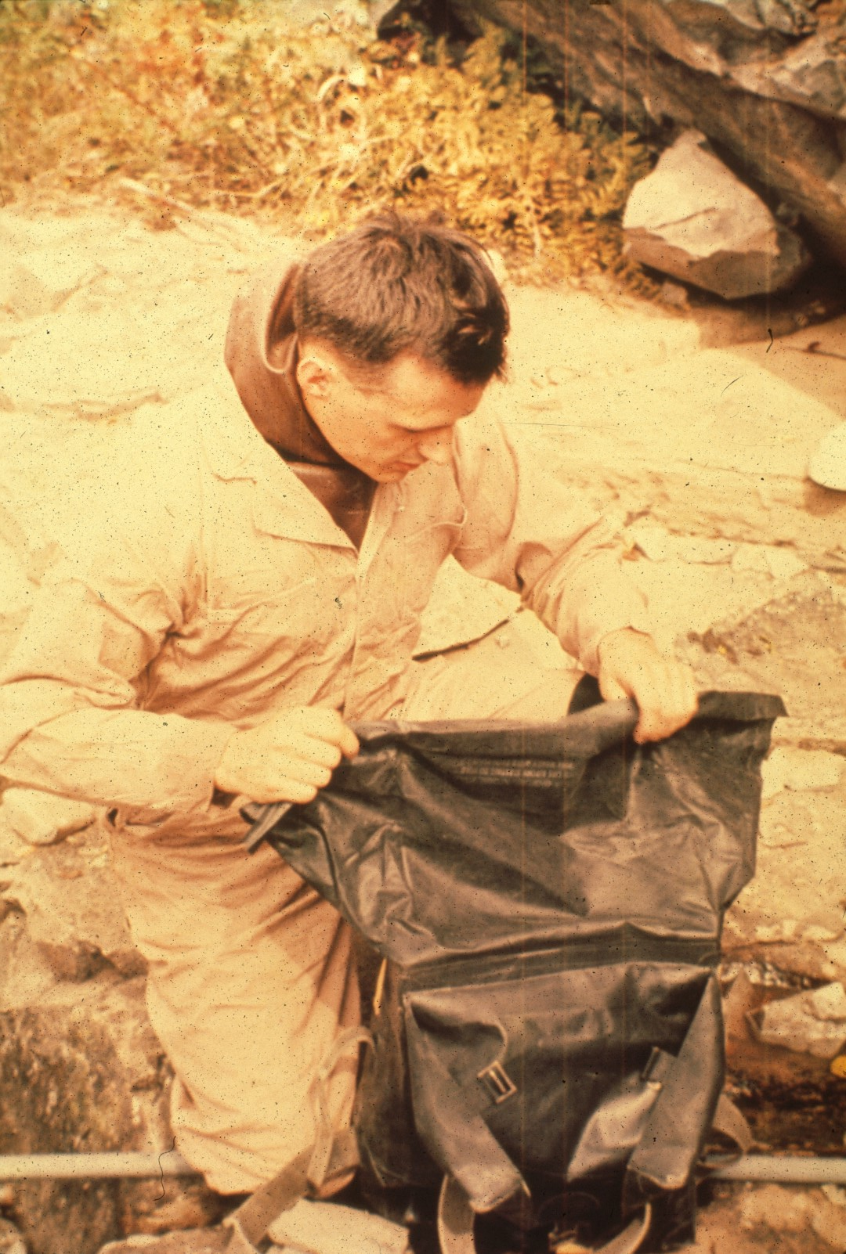
Notes:
Coveralls are worn over the rubber suits to protect them from sharp rocks. Here Bob Dunn is sealing a watertight pack that is used to supplement the "Baloneys". In an effort to reduce the gear that each person has to carry, a support team is again used, and accompanies the assault group into the cave. Even so, there were often times when it was necessary for members of the party to carry three heavy packs apiece.

Slide 17
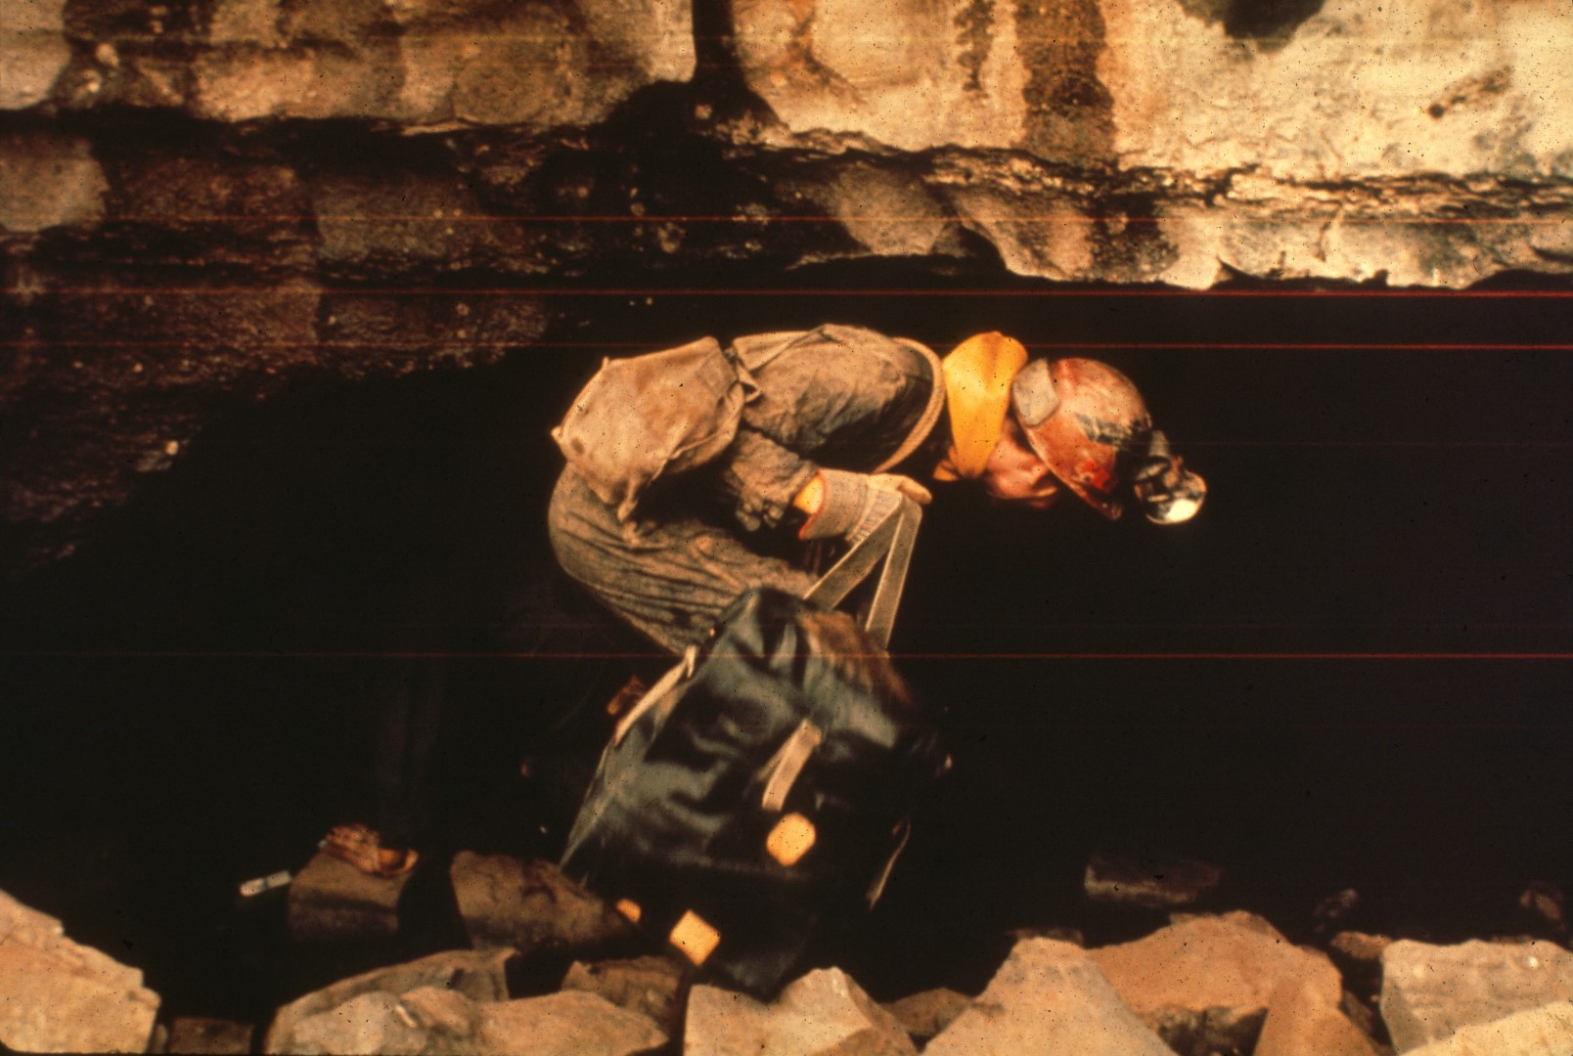
Notes:
Finally, everything is ready end it is time to begin the long trip.

Slide 18
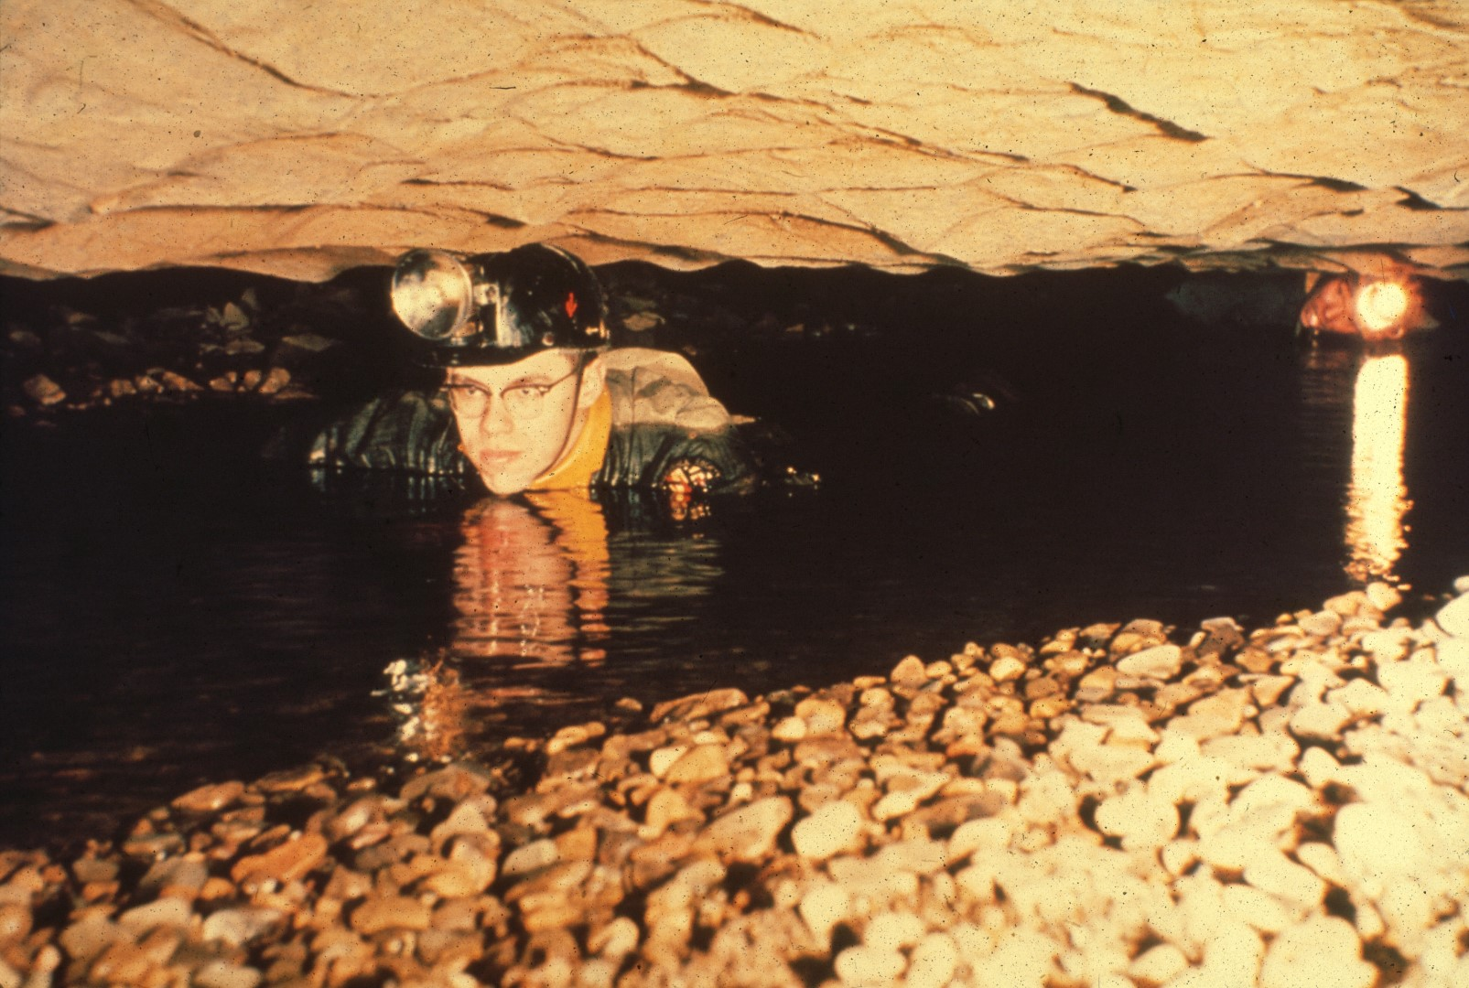
Notes:
Almost immediately, the cave flattens to a low crawlway about one hundred feet long. Prior to 1956, lure of this passage was passed up by all who ventured few feet inside the entrance. Because Bill Davies, in his massive 1948 survey of West Virginia caves did not venture to push this most uncomfortable looking lead, it has been affectionately nicknamed the “Davies Didn’t Crawl”.

Slide 19
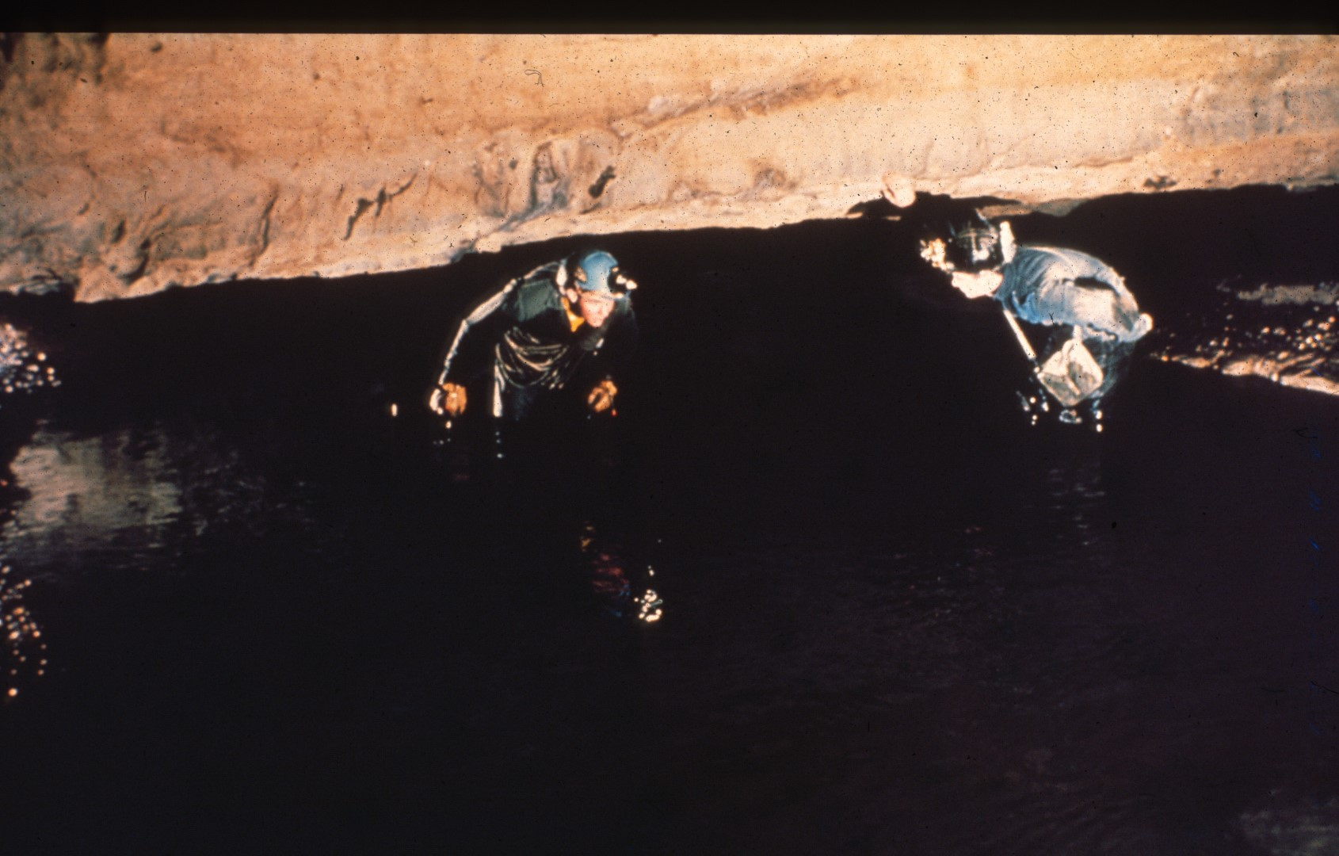
Notes:
The ceiling rises abruptly, and we can splash out of the knee-deep pool onto dry land. We find ourselves in a sizable room, an indication of the large size that much of the remainder of the cave assumes. From one wall the stream bubbles out of an impassable siphon.

Slide 20
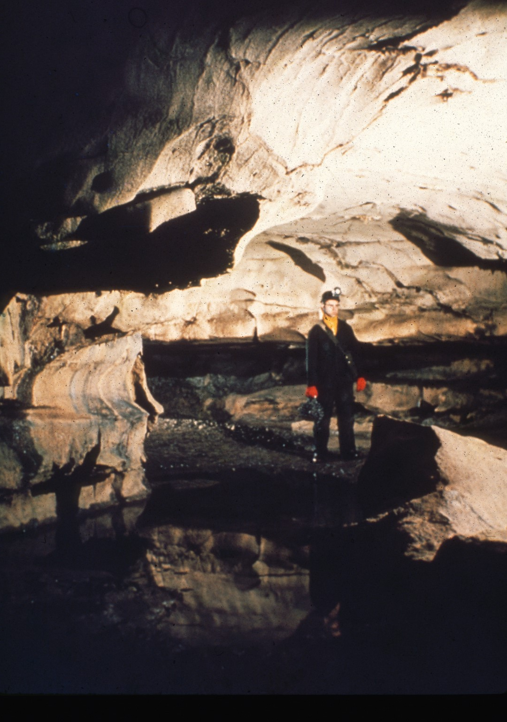
Notes:
But a nearly dry gallery bypasses it, and soon deposits us once again in the frigid waters of the stream.

Slide 21
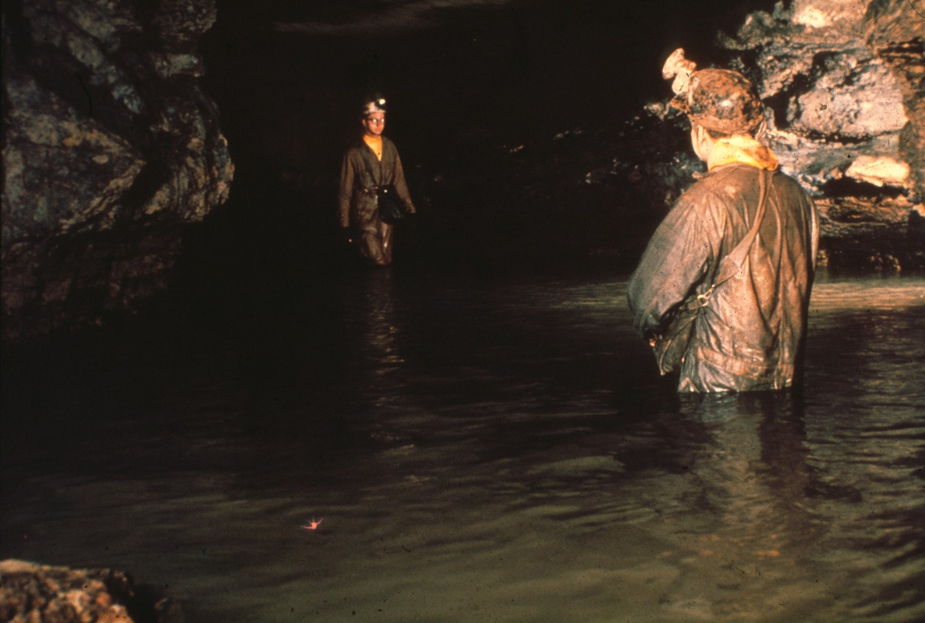
Notes:
The long entrance passage, Neptune's Avenue, extends for nearly three quarters of a mile, with wall-to-wall water ranging from ankle to waist deep. In early spring the current is so swift that it all but sweeps you off your feet. But most of the time the actual flow of the stream is fairly slight.

Slide 22
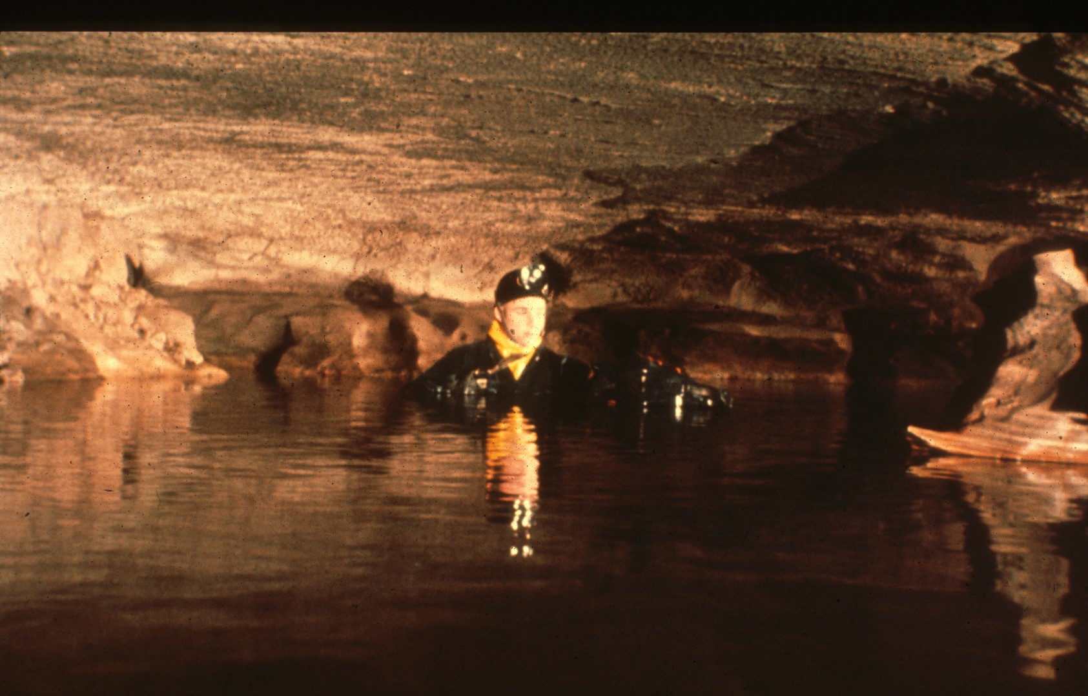
Notes:
At one point not far from the entrance, we encounter lake Rita. Although pushing through its chest deep water can be pretty tiring, there is one substantial benefit: the waterproof packs float and can be effortlessly towed along.

Slide 23
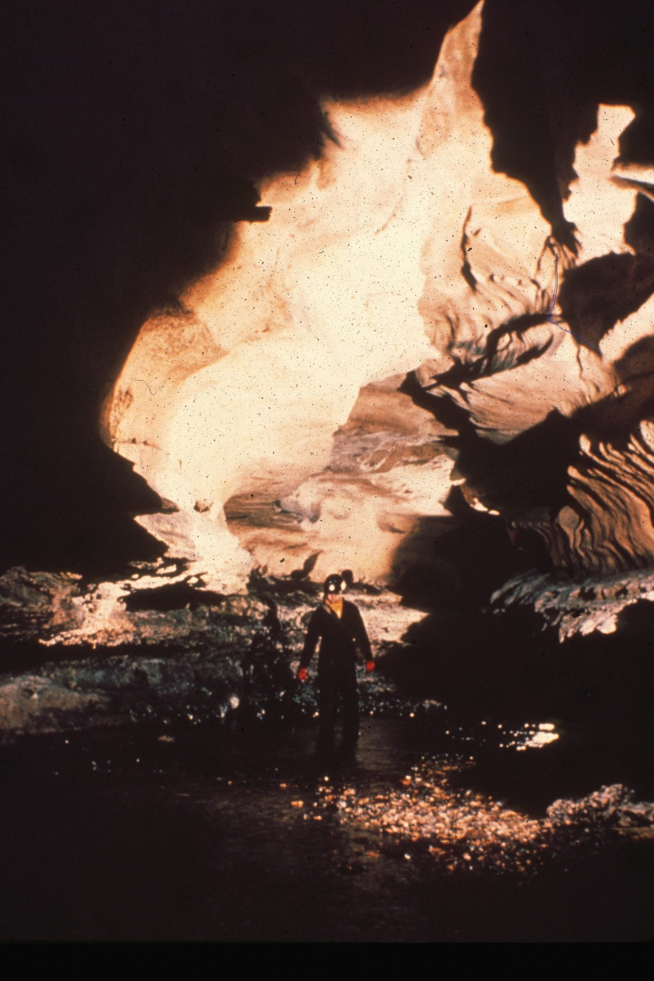
Notes:
In other places the stream splashes in shallows over the gravel bed and sets up a murmur that reverberates from the clean smooth limestone walls. Tiny waterfalls whispering down the walls, along the way add to the sound. But when the water is high, the floor is a mass of churning rapids, and the roar is deafening. Once we made a hasty exit from Neptune's Avenue when the stream was in full flood, and few of us will never forget the experience. But now the stream is calm, and we can push on into the cave with confidence. It was near this point that the first exploration team, unprepared for the cold water, reluctantly turned back, and returned to the surface.

Slide 24
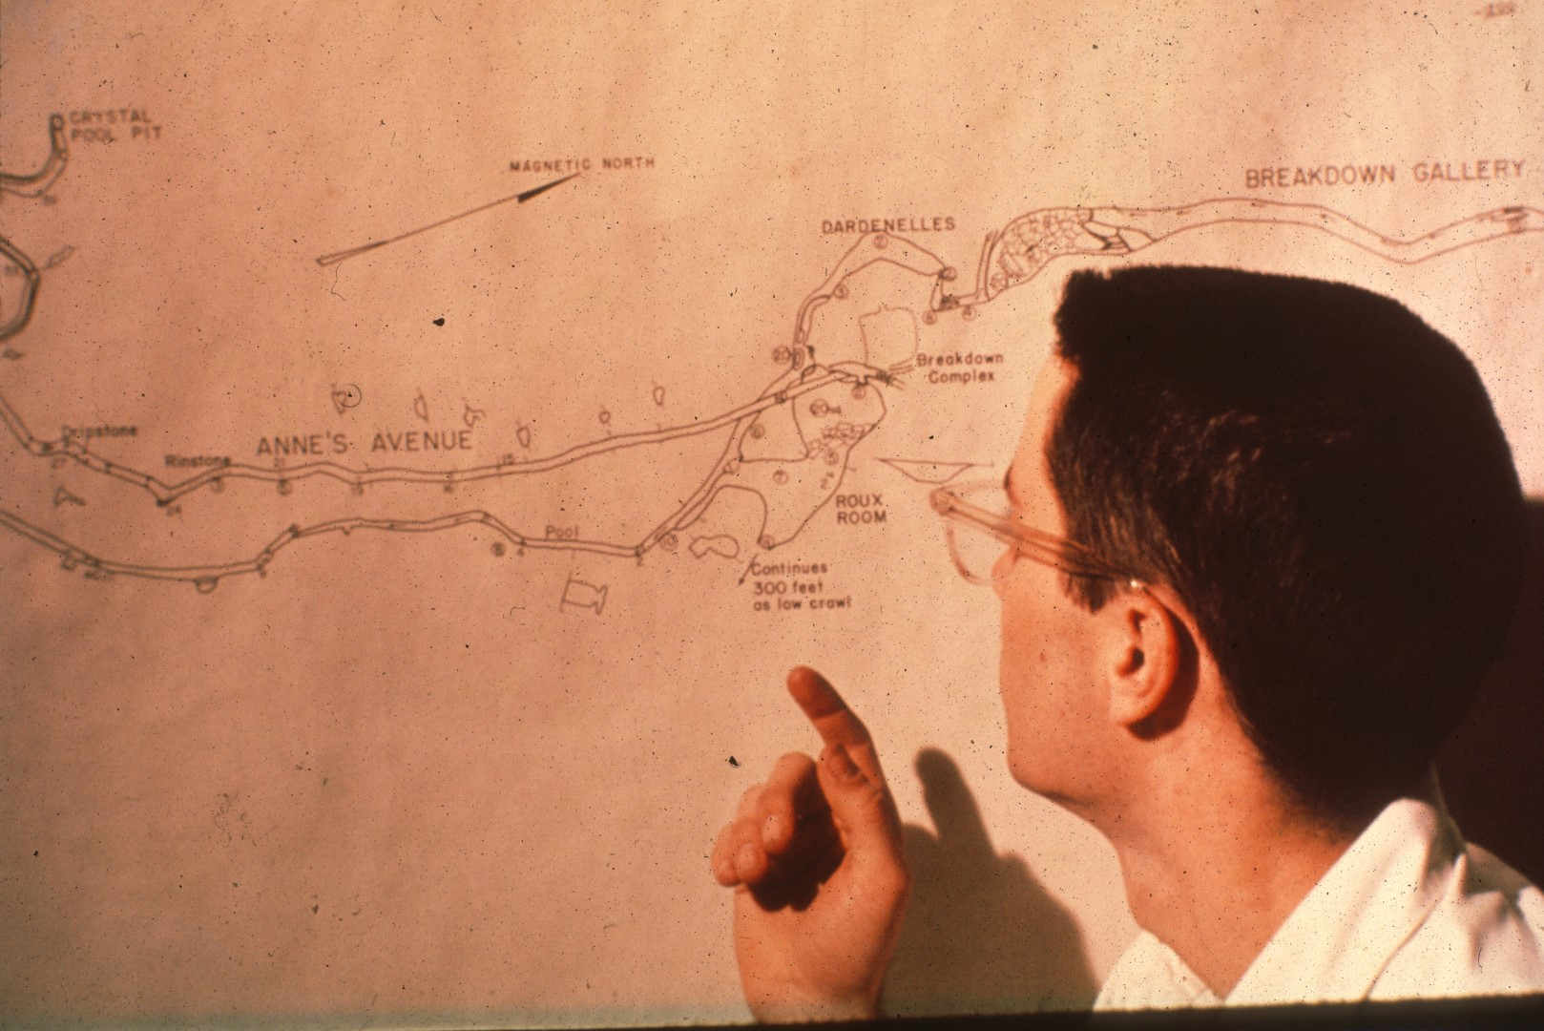
Notes:
We're now approaching a critical portion of the cave. First, we come to the Roux Room, a pleasantly dry ands and sandy resting place, from which Anne's Avenue, one of the longer side passages, takes off. Back in the main stream passage, the ceiling again lowers, and we soon encounter what has come to be named "The Dardanelles”.

Slide 25
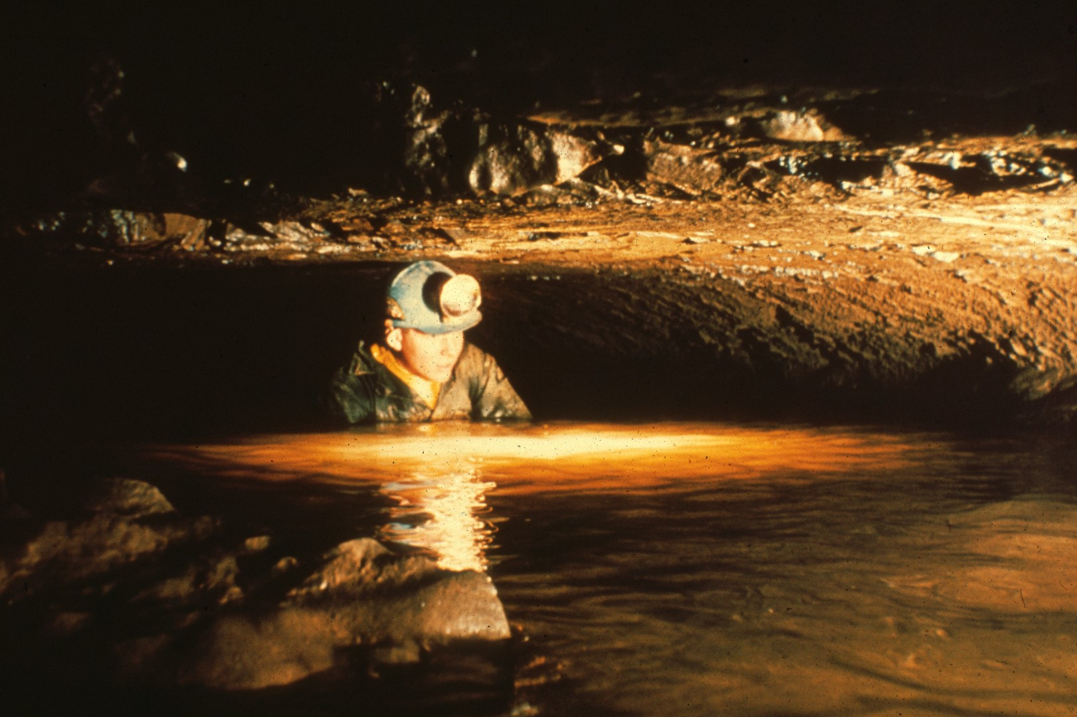
Notes:
In November 1956, five Grotto members returned to Overholt and were the first people to make their way through this rather humid passage.

Slide 26
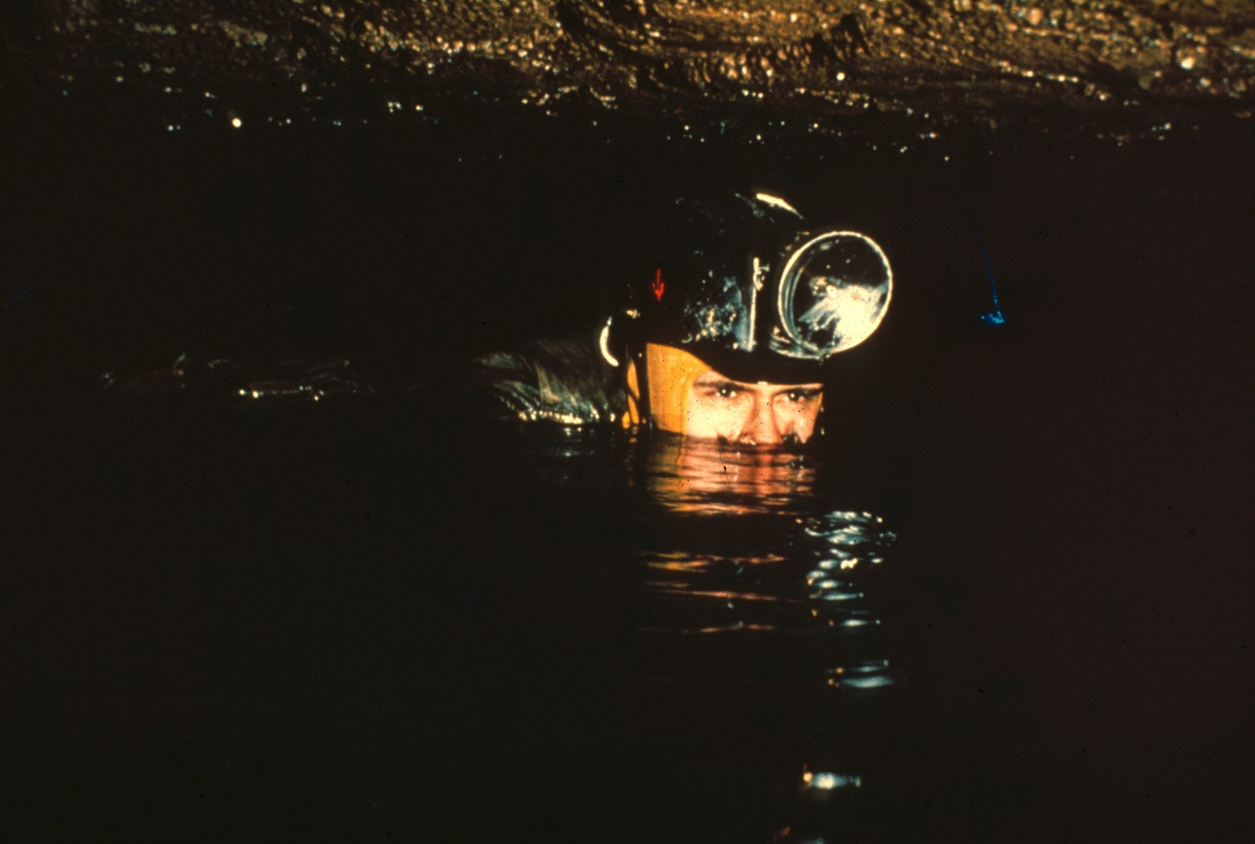
Notes:
Though early explorers found little to relish in this section of passage, the use of dry suits has made traversing “The Dardanelle" almost pleasurable. Here Bruce Godwin chugs his way down the passage, half crawling, half swimming.

Slide 27
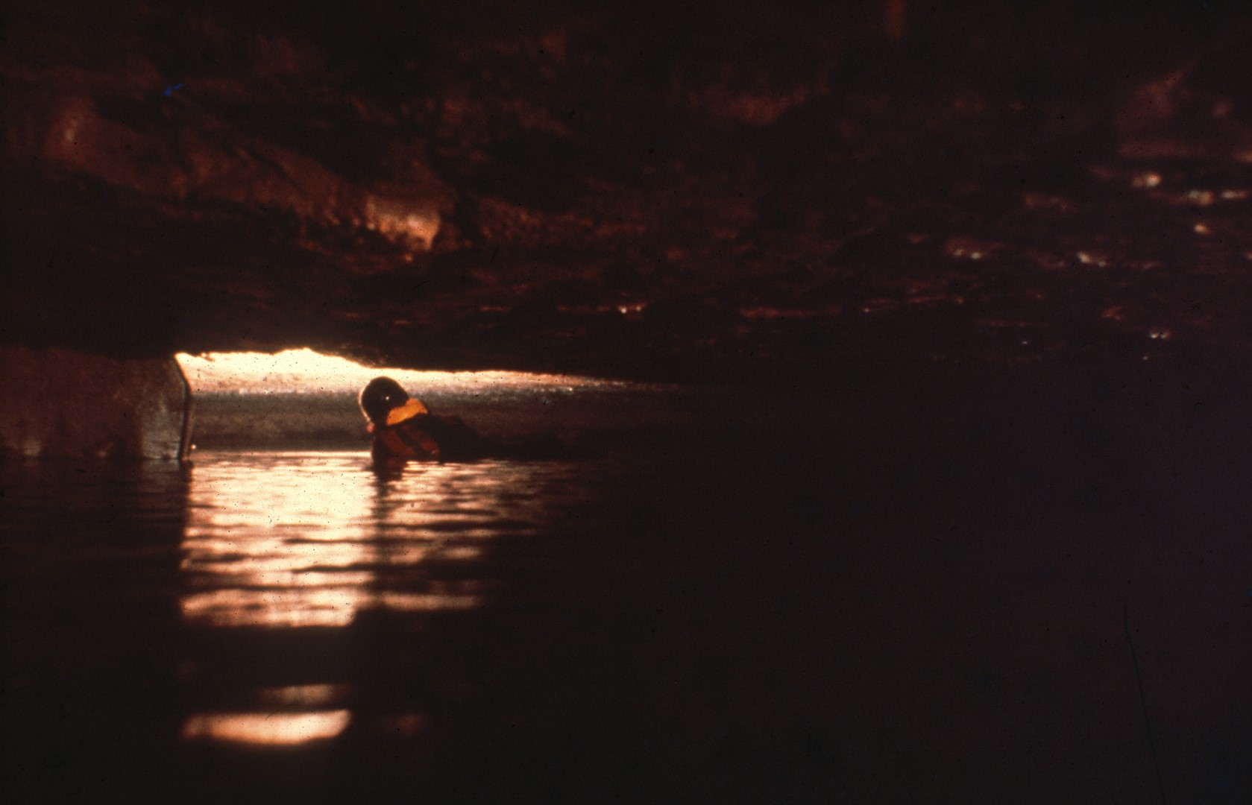
Notes:
The Dardanelles are roughly two hundred feet long, and this is the only part of the cave that is liable to flood after a heavy rain. During the Grotto's first extended stay in the cave, a heavy downpour on New Year's Day, completely flooded this passage, while six members of the assault team were still in the cave.

Slide 28
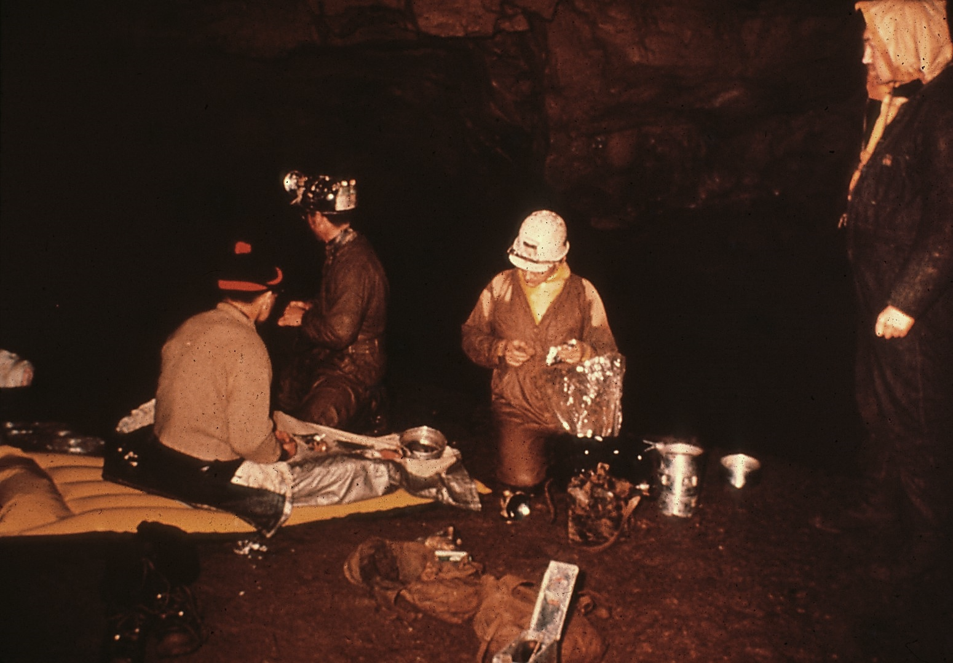
Notes:
On returning to the Dardanelles and finding the way blocked by water, the group settled down to wait, made themselves comfortable, and brewed a pot of tea. The fellow on the right is Oliver Wells, a well-known British cave diver who now lives in Pittsburgh. He wears a very unusual dry suit. Made in two layers, the suit can be filled with air, transforming slim Oliver into fat Oliver, and cold Oliver into warm Oliver.

Slide 29
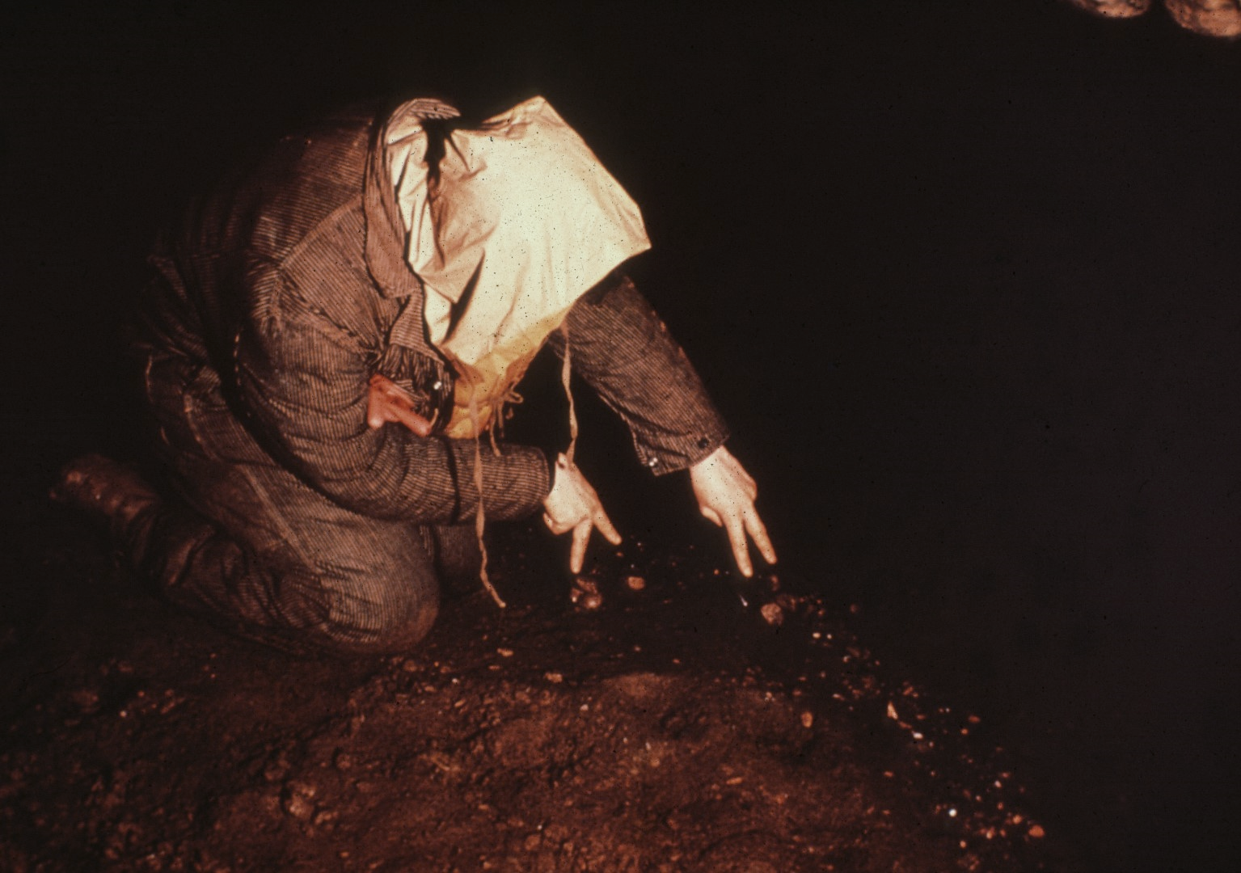
Notes:
Here Oliver, all inflated, points out markers stones which he used to measure the slow retreat of the water. Within six hours the water had receded enough to allow the group to get through the Dardanelles. Since there was only an inch or two of airspace above the swirling waters, it was an exciting exit. Unfortunately, none of the photographers present had sufficient presences of mind to take a picture of this operation. The team was greeted on the other side of the Dardanelles, by members of the Baltimore Grotto, who had hastily improvised an ingenious diving rig. The falling water levels, however, made its use unnecessary.

Slide 30
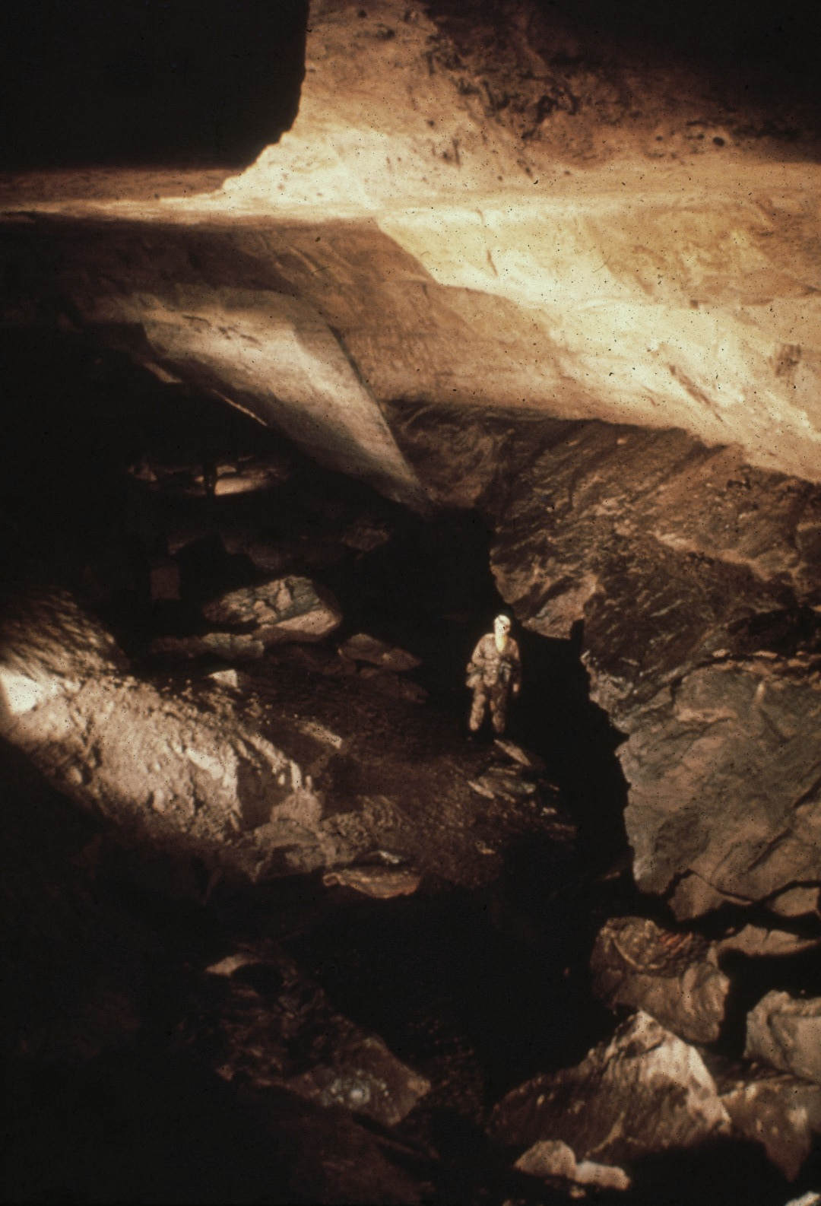
Notes:
But let’s continue with our trip through the cave. The cramped quarters of the Dardanelles quickly open into a huge breakdown gallery.

Slide 31
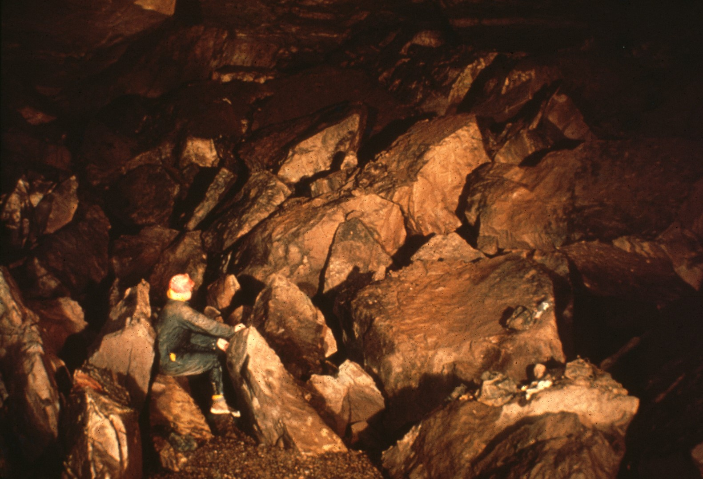
Notes:
The gallery becomes a succession of easy strolls, broken by stretches of massive breakdown.

Slide 32
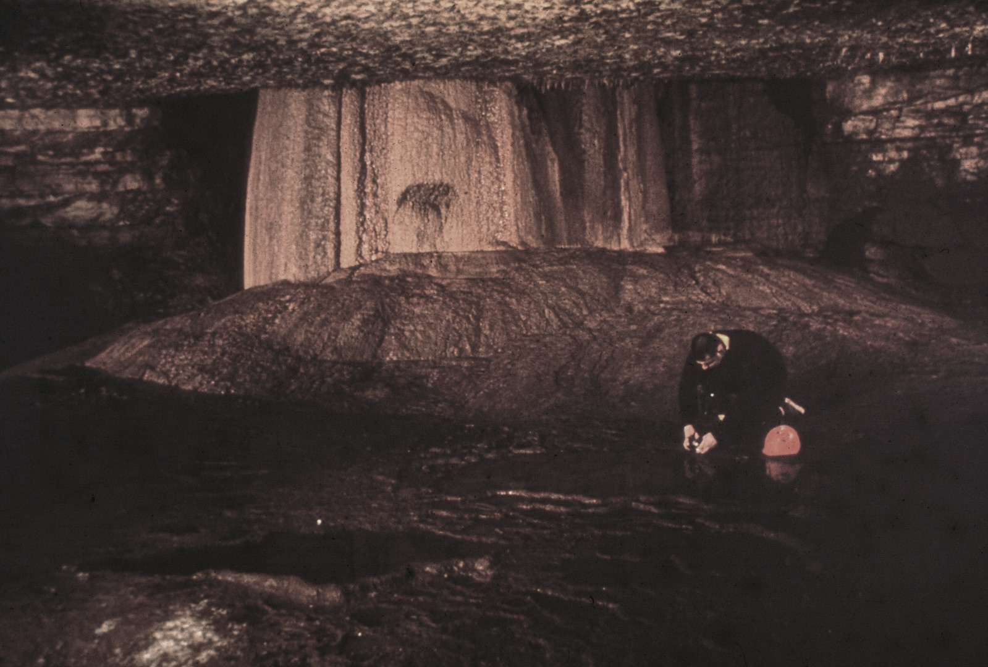
Notes:
Before long we reach the mountain room, exactly one mile from the entrance. This room contains the largest formation in the cave. The huge stalagmite in the background is at least twenty feet high. Unfortunately, the ceiling is only eight feet high here, and the stalagmite rises inside a narrow dome, almost completely filling it. Only by chimneying up between the stalagmite and the wall of the dome, is it possible to view the entire formation.

Slide 33
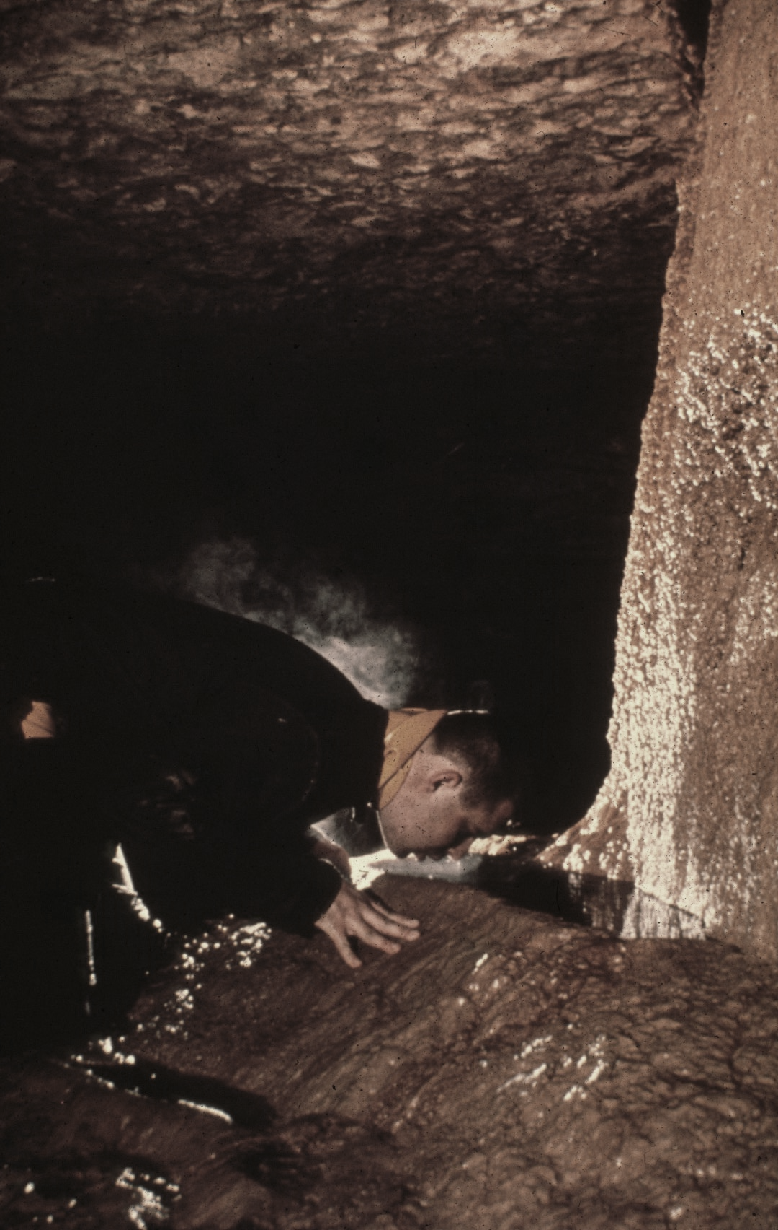
Notes:
A rimstone pool, at the base of the formation, serves as a convenient drinking trough. This is the only place where the cave water is drunk directly. Everywhere else it is either first treated with halazone, or bourbon.

Slide 34
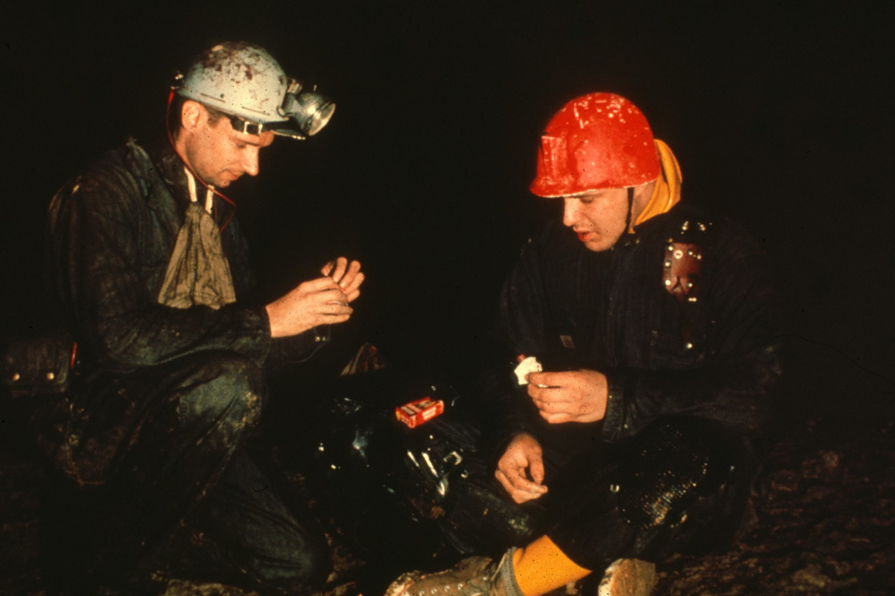
Notes:
The Mountain Room also serves as a pleasantly dry place for a quick snack.

Slide 35
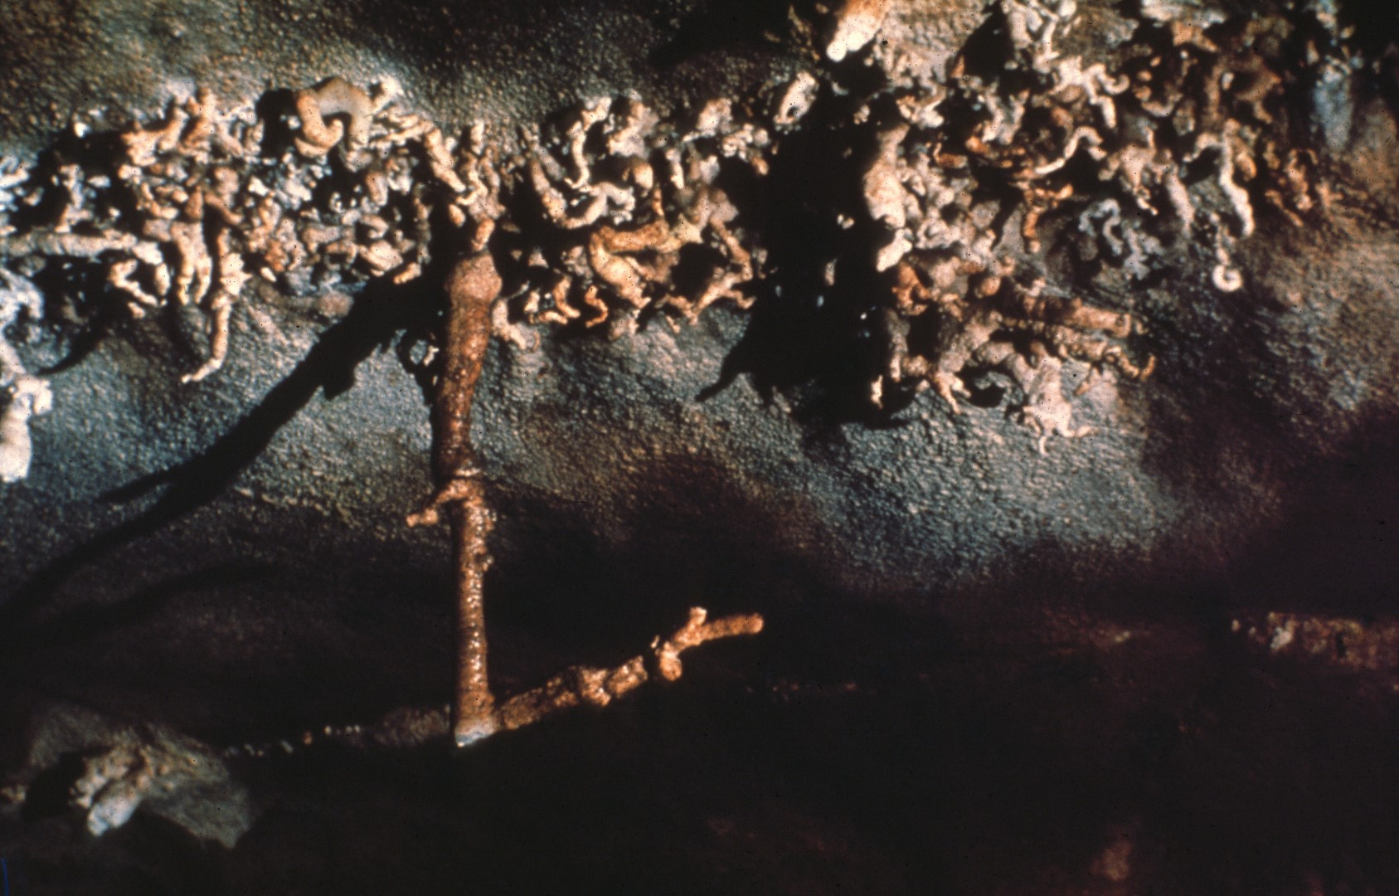
Notes:
Immediately beyond is the helictite gallery, with its prominent display of pointing stalactites. Some point into the cave, others point out, but all tend to line up with the passage.

Slide 36
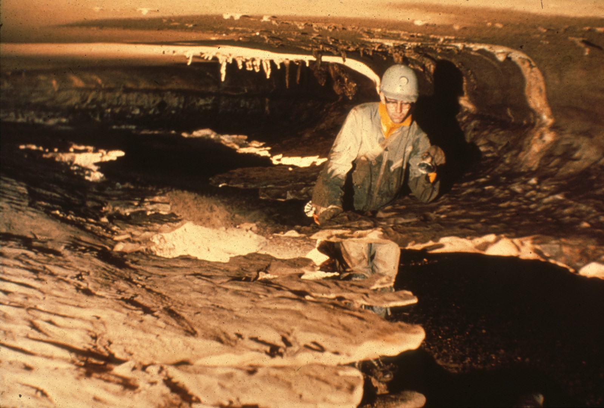
Notes:
The first mile of Overholt was the easiest, and the passage now alternates between stream sloshing, and crawling through breakdown. Here Bill White examines the shelf stone in the Tomtom Gallery, so named because these thin shelves of bedrock vibrate audibly when struck with a fist. This was also the point where the third exploring team to enter the cave turned back for lack of carbide, in June 1957.

Slide 37
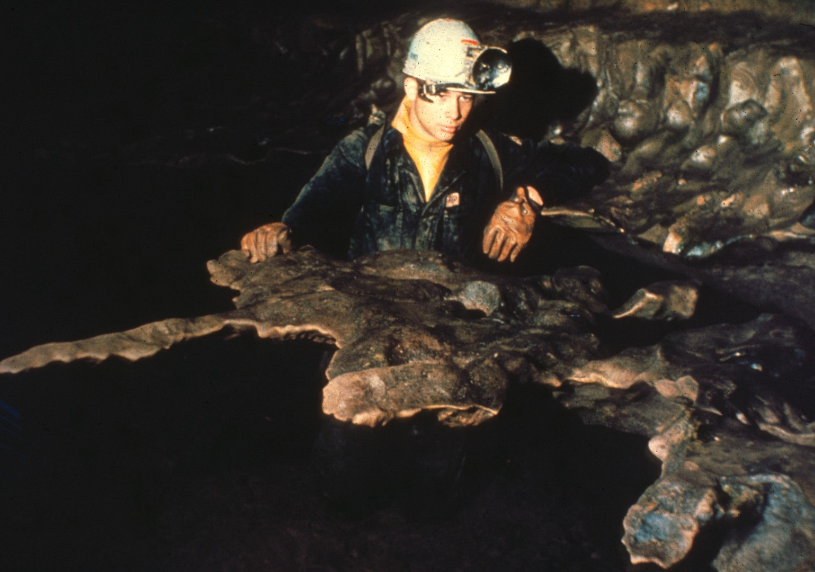
Notes:
This is called The Table, and the only point of attachment is a small neck at the right. The rock vibrates noticeably when struck.

Slide 38
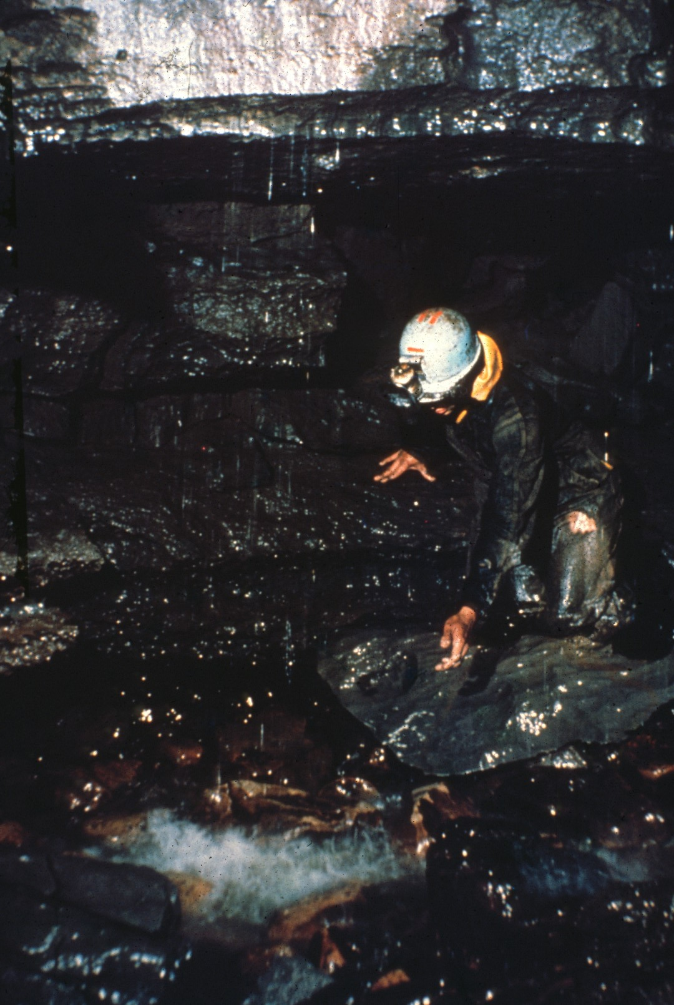
Notes:
As the two-mile mark is approached, a dull roar in the distance announces the first waterfall, which sprays from a small hole in the ceiling.

Slide 39
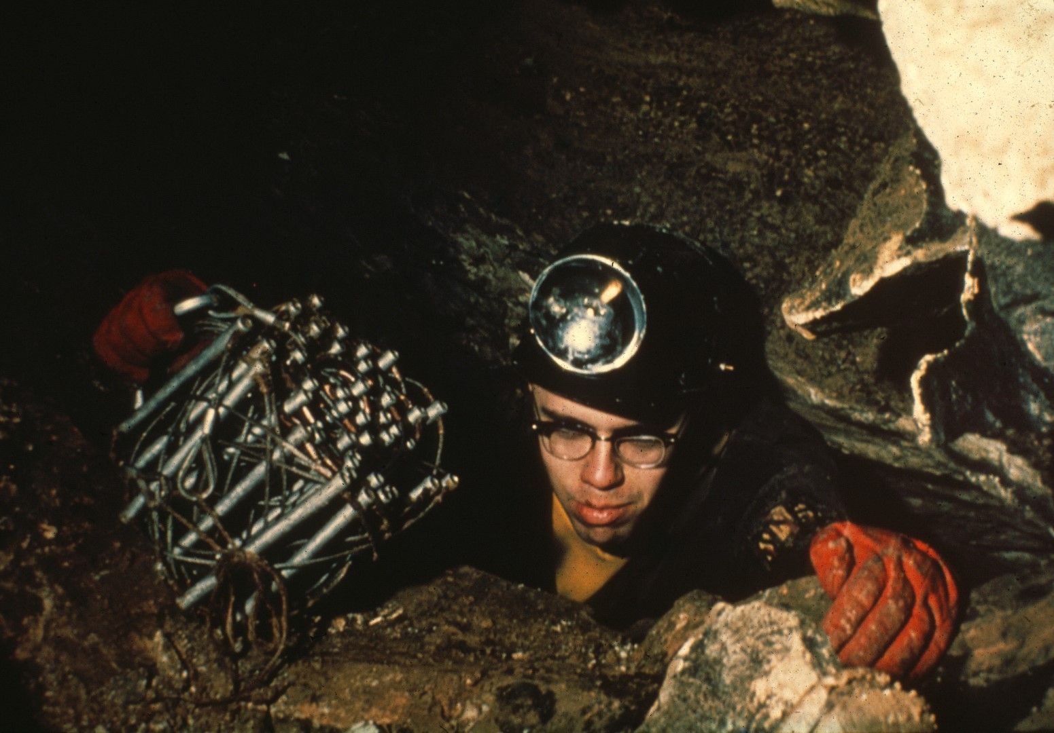
Notes:
Climbing up with a cable ladder.

Slide 40
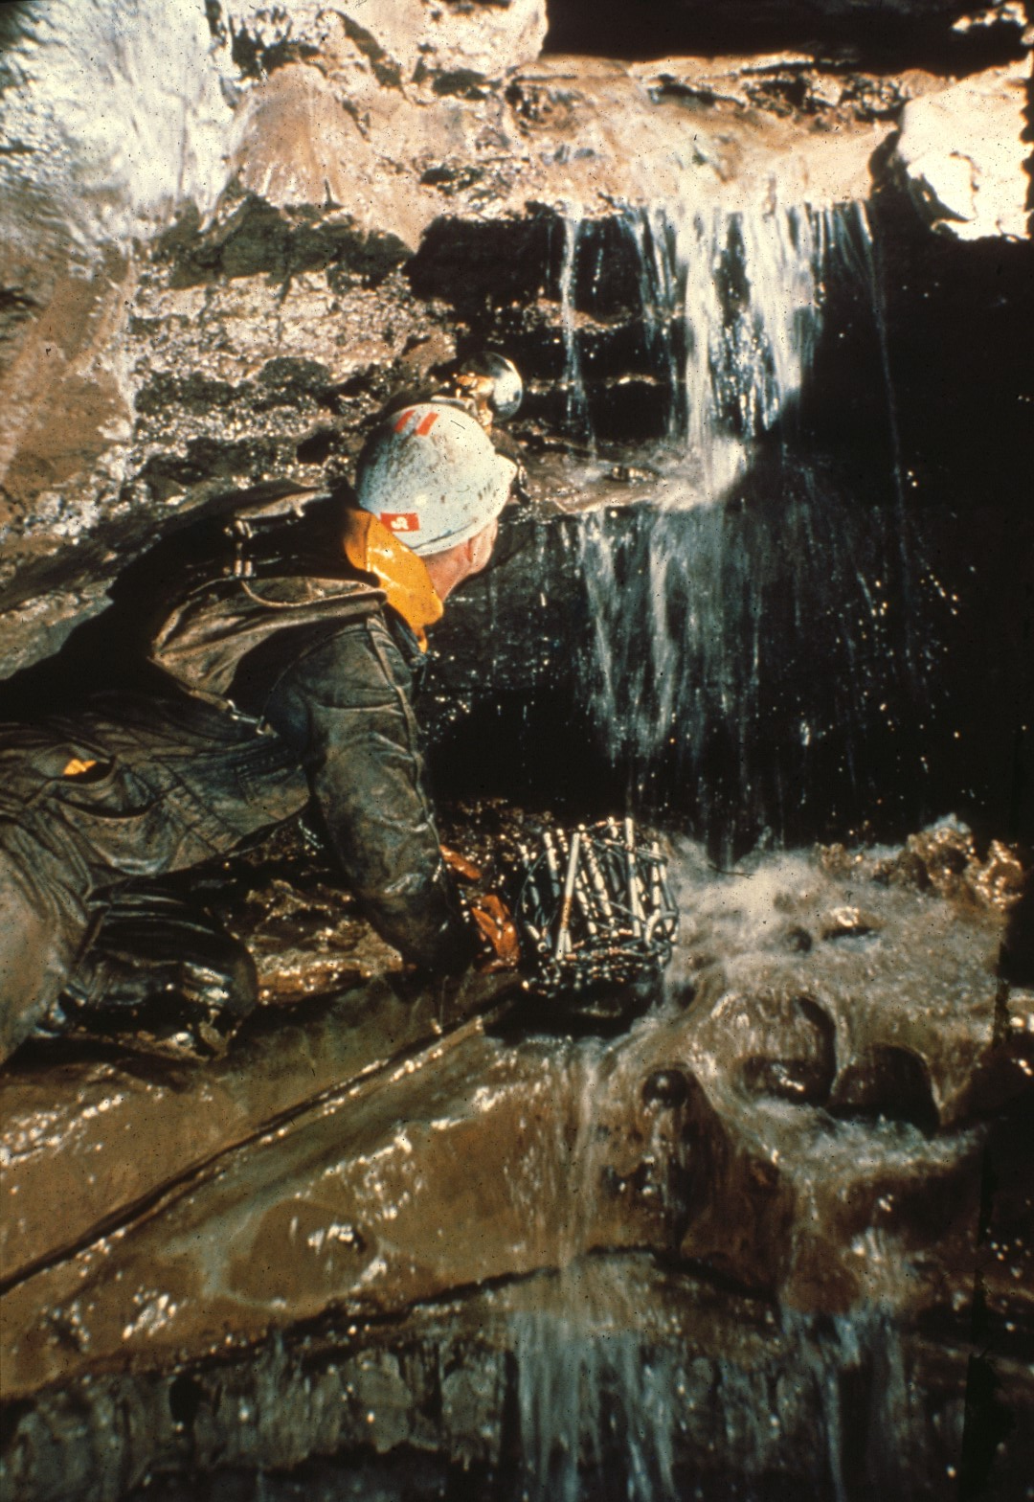
Notes:
Only about fifteen feet high, this waterfall is easily climbed, and the narrow streambed leads us on…

Slide 41
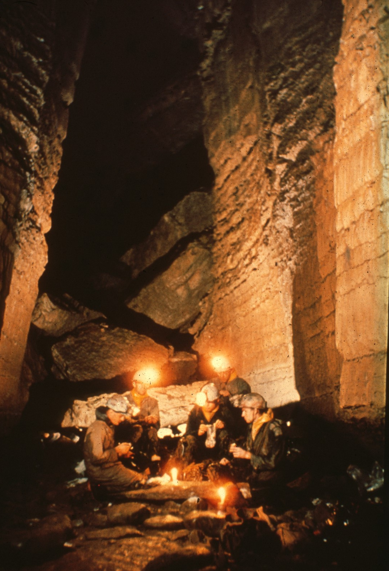
Notes:
Into the Catheral. This one of the most impressive rooms in the cave, with its fluted, over hanging walls soaring high beyond the reach of our lamps.

Slide 42
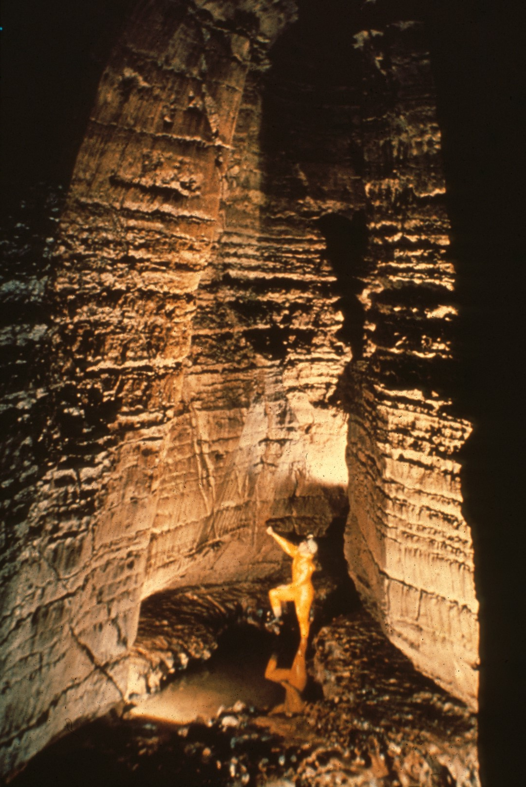
Notes:
This shot shows an accurate profile of the Catheral. And clearly shows how the fluted walls come closer together as they approach the top of the picture. At the end of this room is the second waterfall, which, no doubt carved out this unique profile as it receded.

Slide 43
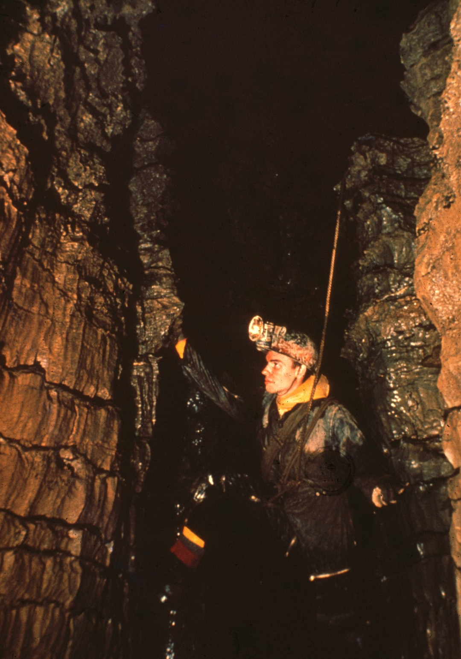
Notes:
Several obstacles remain before the campsite is reached. Most imposing is the sixty foot climb up the second waterfall. Here Bill Plummer begins the climb with an easy chimney to the ridge which can be seen at the top left.

Slide 44
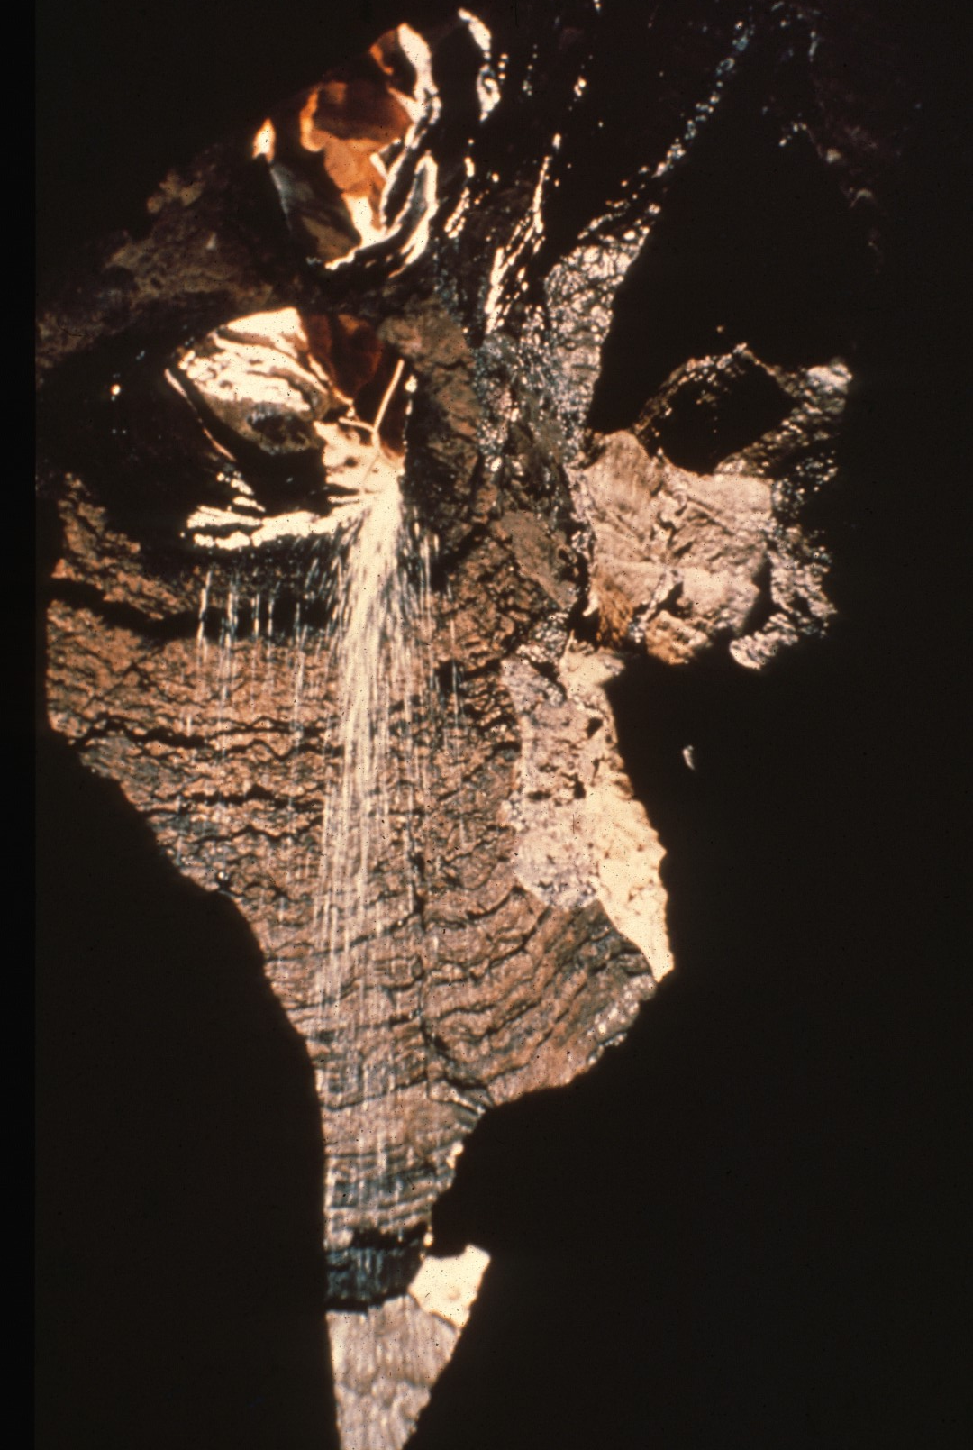
Notes:
Looking upward from this ledge, one can see the second waterfall pouring through a port hole at the top of an adjoining dome. The climbing route lies directly up the center of this picture.

Slide 45
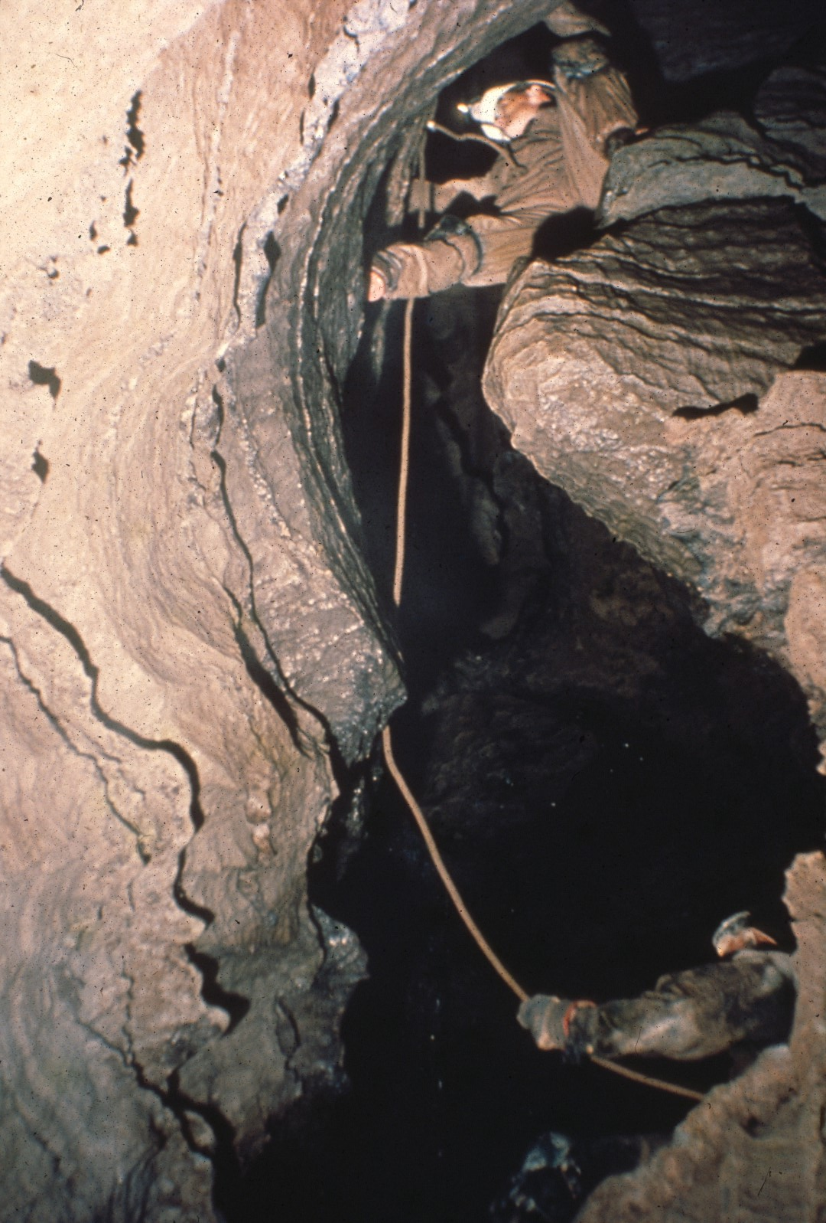
Notes:
Expansion bolts driven along the way provide anchors for the belay rope.

Slide 46
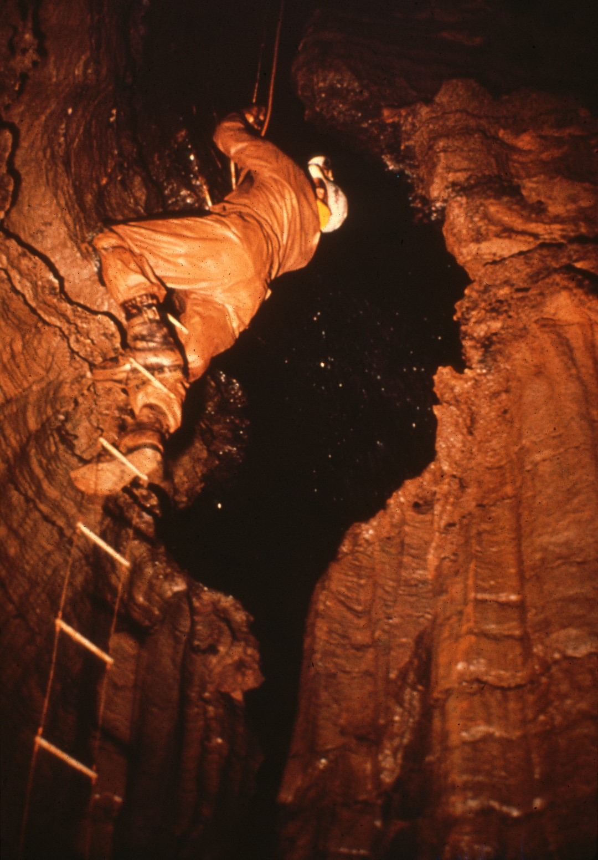
Notes:
Finally, a ladder is rigged, and the rest of the party can continue with relative ease. All the accumulated gear is hauled up. And now the assault team begins to move supplies to the campsite. Only one obstacle remains.

Slide 47
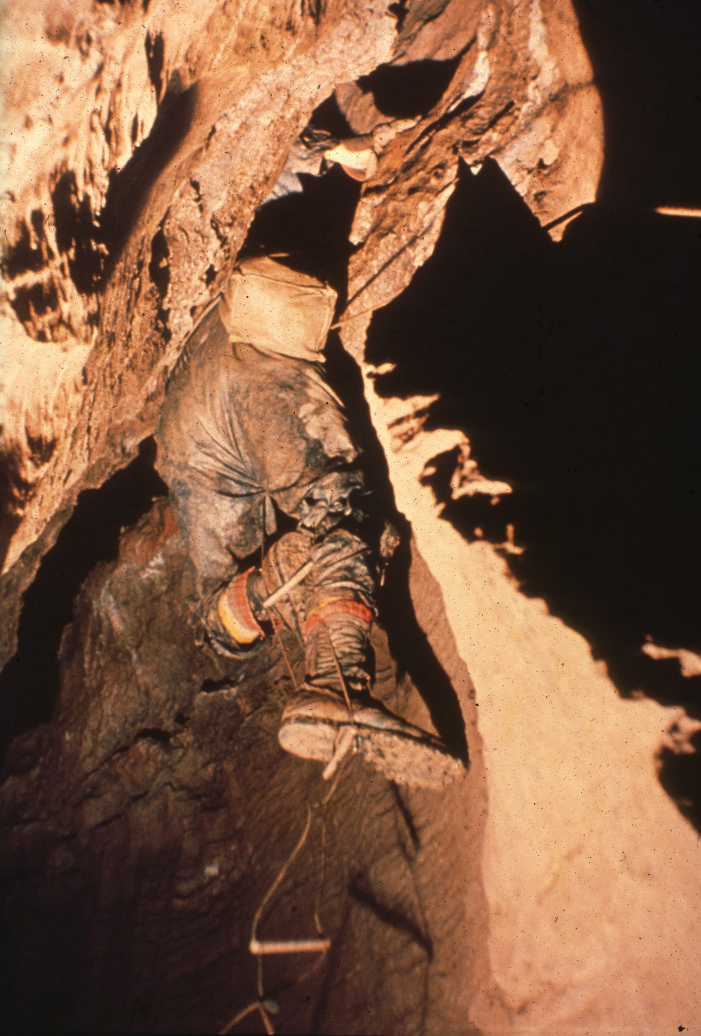
Notes:
The stream soon leads to the third waterfall. But the only passable route bypasses it by climbing through a narrow crack in the ceiling of a small alcove. This is Jones's Squeeze, and it is so narrow that some of the bulkiest packs won't fit through and must be hauled up the waterfall itself.

Slide 48
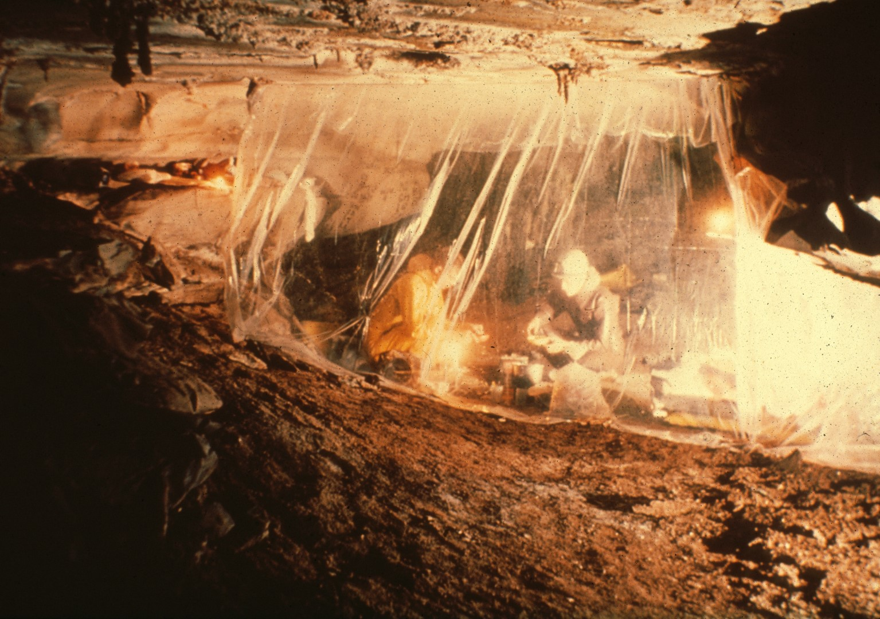
Notes:
At last, we reach the turnpike, a natural place for a campsite, with a dry sandy floor and a comfortable ceiling height. Instead of using tents, sleeping bags are left in the open, while a plastic windscreen deflects the steady breeze to the other side of the passage.

Slide 49
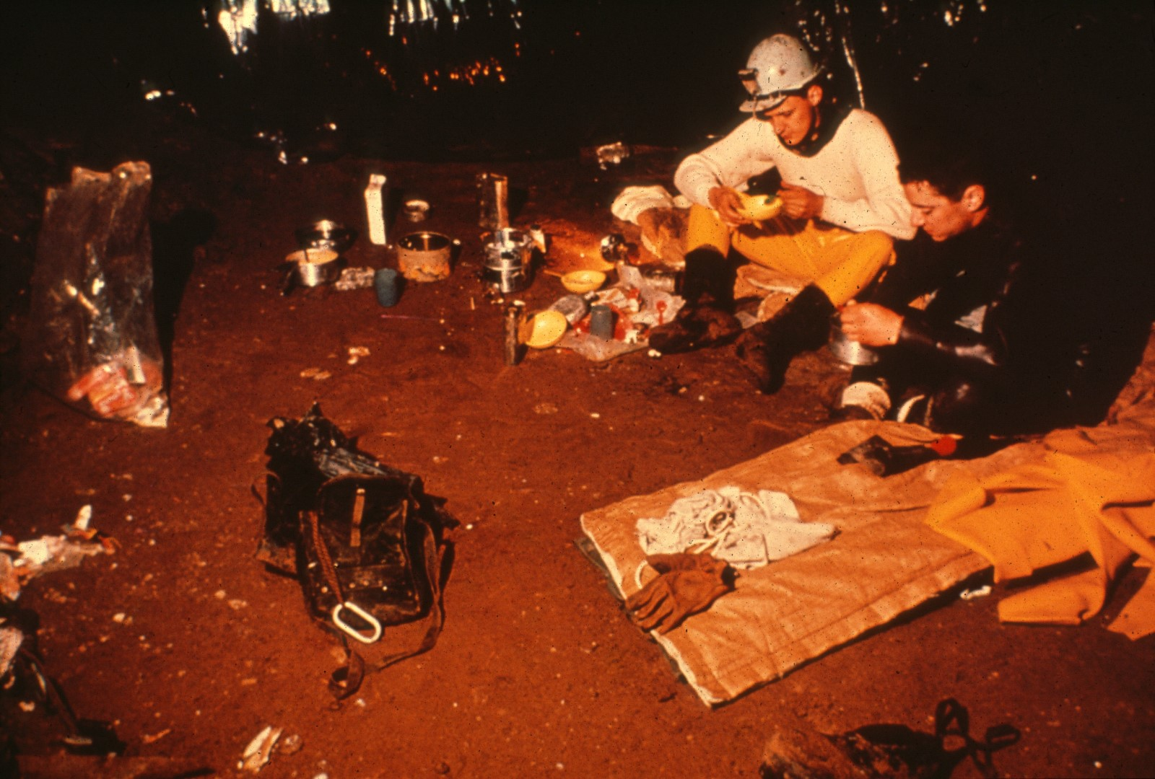
Notes:
Two hot meals are eaten each day, spaced about eleven hours apart, while candy bars and glucose tablets serve as snacks. Fred Kissle and Bob Dunn are here enjoying a meal prepared from dehydrated foods on a small primus stove. Fred is sitting on a paper throwaway sleeping bag that has been used with some success on several trips. A large portion of the supplies were left in the cave to maintain a permanent campsite.

Slide 50
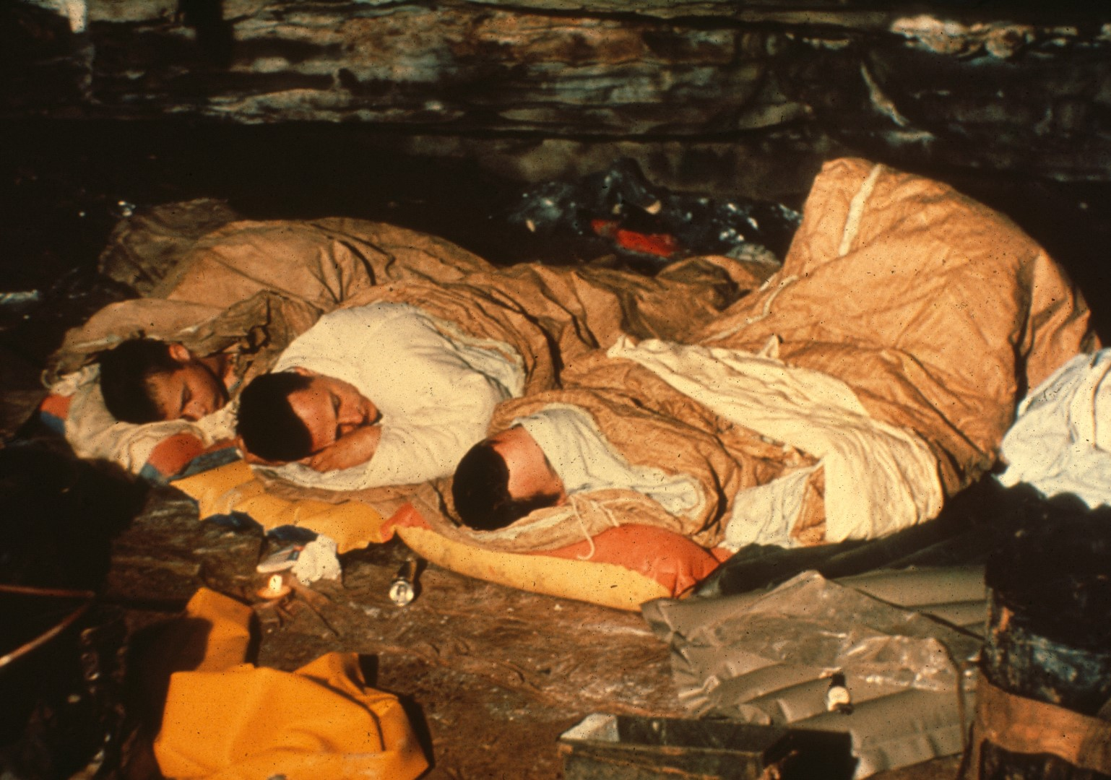
Notes:
By now, everyone is pretty tired from the long trek into the cave, and eight hours of sleep is next on the agenda. The camp settles into darkness...

Slide 51
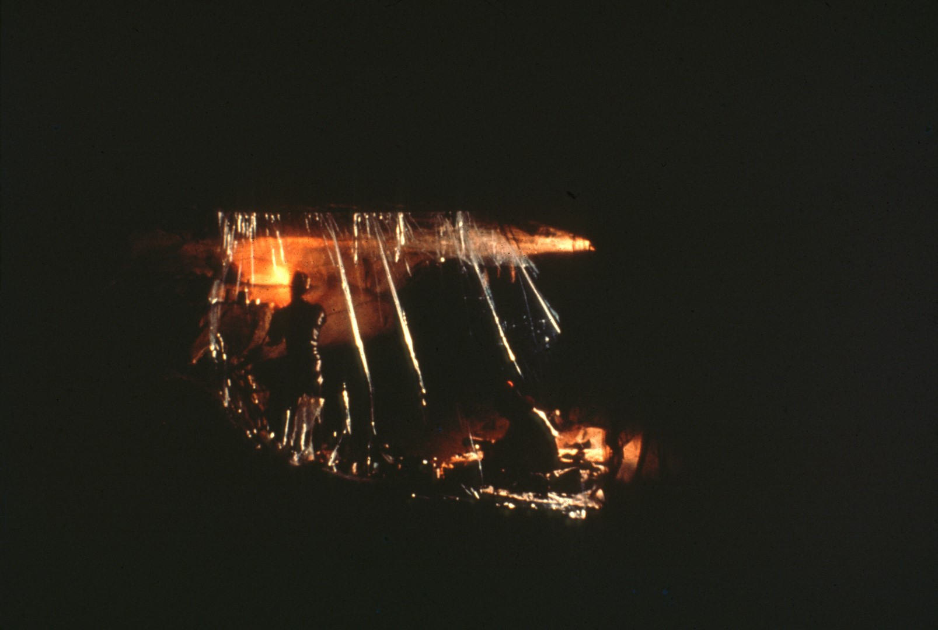
Notes:
As the last man up blows out the candles and carbide lamps.

Slide 52
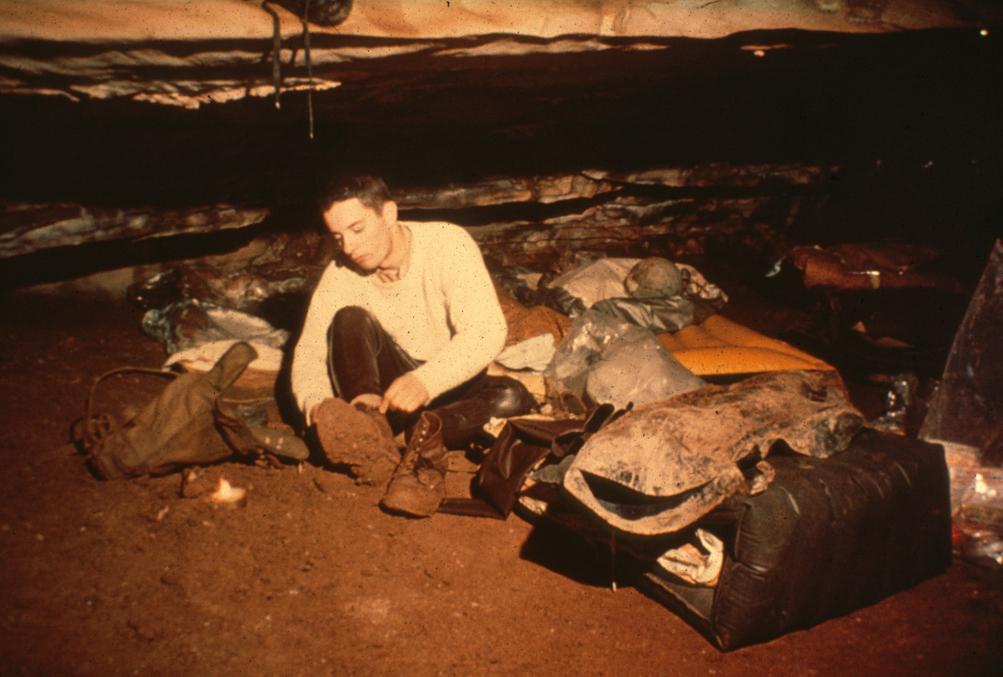
Notes:
Waking up in the morning brings the sudden shock of realizing that you're deep underground, and not under a starry sky. The morning also brings the day's most unpleasant task: getting out of a warm sleeping bag...

Slide 53
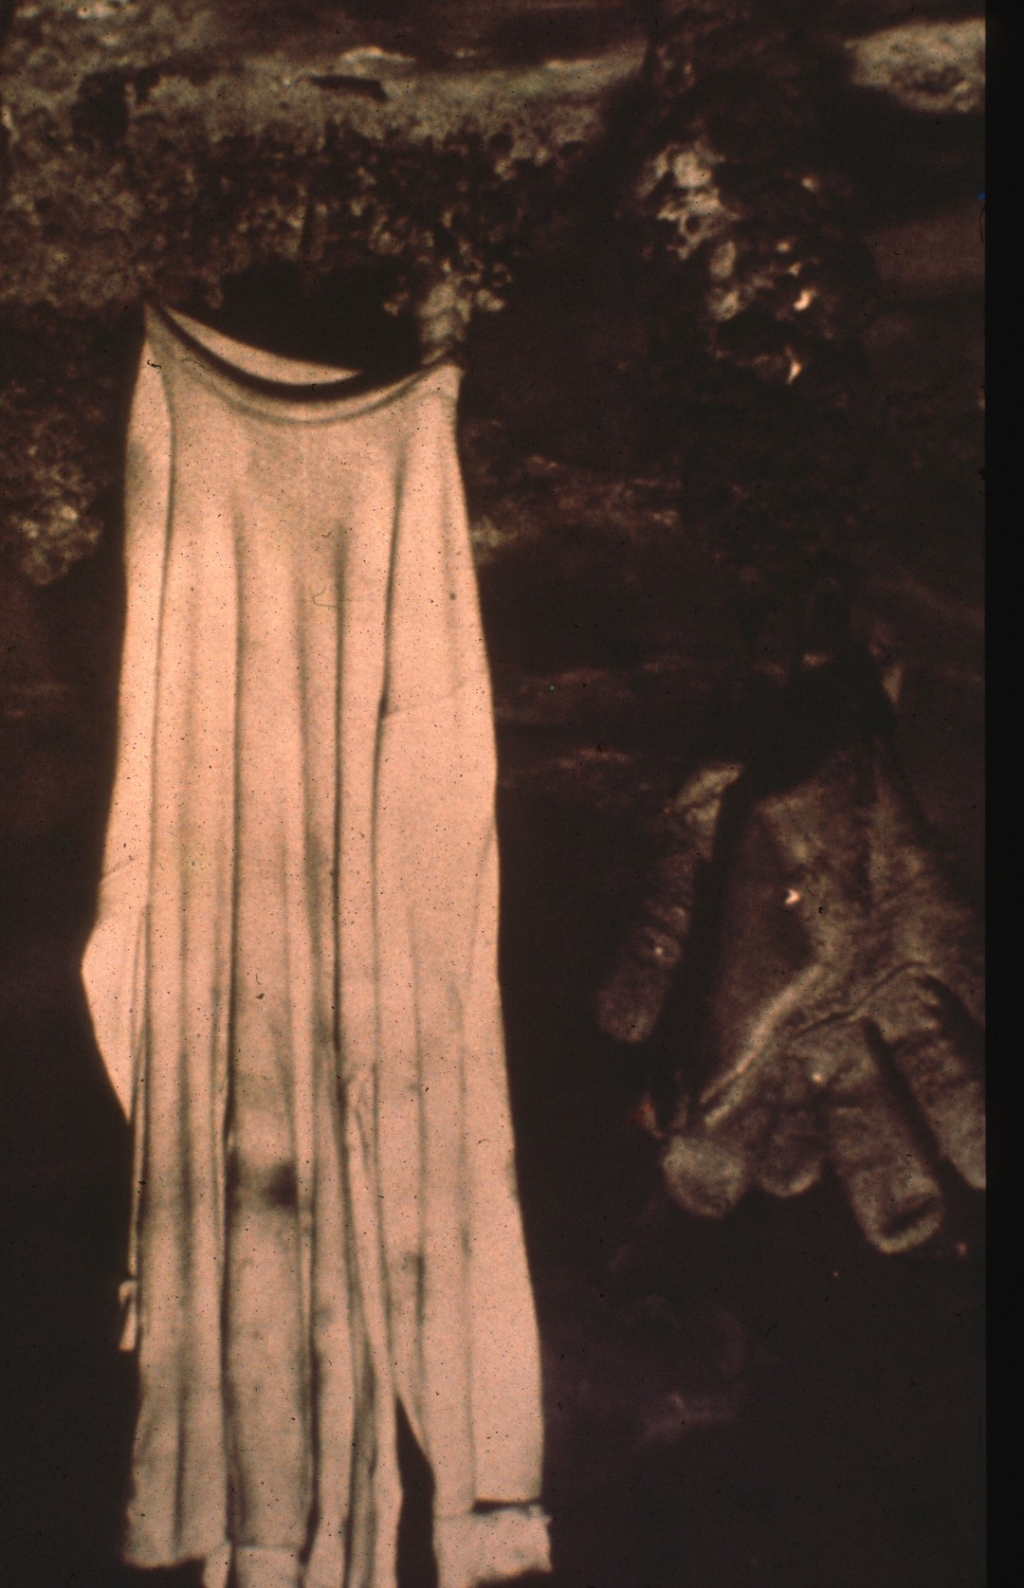
Notes:
And getting into the cold clammy clothes that you abandoned the night before.

Slide 54
Notes:
The whole ugly task of getting into those dry suits has to be repeated. And here Oliver, now completely deflated, fires up his lamp in anticipation of the day's business.

Slide 55
Notes:
The objective of this 1960 New Year's Day trip lies only a couple of thousand feet further down the passage. The fourth waterfall cascades down the wall of Disappointment Dome. And a slightly different temperature in this part of the cave convinced us that we were near another unknown entrance.

Slide 56
Notes:
Free climbing was impossible here, so tension climbing was adopted. Here Alan MacCready is setting the first of a series of expansion bolts that will provide us with an iron route up the waterfall.

Slide 57
Notes:
The work is done in shifts, and the worst part is trying to keep warm while you’re waiting. The waterfall causes a spray charged wind to sweep through the dome, drenching everything, and everyone. A caver has tried to keep warm by wrapping himself and his carbide lamp in a plastic sheet. But judging by the expression on his face, he doesn't seem to have succeeded.

Slide 58
Notes:
Meanwhile, the climb goes slowly on, and after fifteen hours of work, the fourth waterfall is finally surmounted. But the effort doesn't yield much reward. A scant fifty feet leads to the base of an unscalable fifth waterfall. There is no time for this trip to push further.

Slide 59
Notes:
Consequently, on the following Thanksgiving, another expedition, this one designed to last at least four days, is launched against the fifth waterfall. But another method is being used. A thirty-foot length of sectioned aluminum pipe is carried in and assembled in disappointment dome. The battle cry goes up...

Slide 60
Notes:
And the standard is raised, sporting a ladder, not a flag, at its end.

Slide 61
Notes:
With the help of the scaling pole we are now over the waterfall in a much shorter time than before.

Slide 62
Notes:
A ladder is secured at the top, and the team is able to assemble at the top of the fifth waterfall. During these climbs, carbide lamps were continually being put out by the spray. Electric lights were used as a supplement.

Slide 63
Notes:
The beauty of using a scaling pole, is that it can be hoisted up, and used again on the next waterfall. And so, the top of Disappointment Dome was finally reached. By this time, the chill waters had taken their toll...

Slide 64
Notes:
And no one cares anymore how he looks for the photographer. Even the photographer has given up his endless fight to keep his lens free of water, and the cameras are returned to their packs. This is as far as photography has gone in Overholt, but exploration has pushed further. A miserable crawlway continued for a considerable distance, finally ending in a small, low room. In the room the cavers found the nest of a cave rat. Sure evidence that the surface was not far away. What's more, the nest contained two intriguing items: a chunk of asphalt paving, and a ladies' garter.

Slide 65
Notes:
Assuming that the lady, at least had not come in the way we had, we felt certain that this small room could not be many feet from the surface of this valley. We had penetrated completely through the hill on the left, from one drainage basin into another. But the lack of those few extra feet meant that those three miles of cave through which we had come, had to be retraced. With this trip, subsurface exploration in Overholt by the Pittsburgh Grotto came to a virtual standstill. In 1961 and 1962, extensive surface work has been done in the dry creek valley, in an attempt to find Overholt's back door. And a hole by hole search has so far yielded several good digging prospects.

Slide 66
Notes:
None of these have been successful.

Slide 67
Notes:
In one place the map shows that we are maddeningly close. Hause Cave contain a roomy passage that comes within a few feet of the Turnpike Passage in Overholt. But no connection could be made.

Slide 68
Notes:
One of these days either by luck or by dynamite, a back door will be open, and a complete traverse of the cave will leave the caver with a three-mile cross country hike to reach the point of his original entry. For the main passage of Overholt runs nearly in a straight line. When that day comes, many of the remaining unexplored leads above the second waterfall can be checked out with relative ease. Meanwhile Overholt invites further exploration into its depths, and those who accept the invitation will find it a fascinating cave.

Slide 69
Notes:
THE END. This program has been presented by the Pittsburgh Grotto in association with the Visual Aids Committee of the National Speleological Society.
Note: This script was transcribed from a tape recording, portions of which are nearly unintelligible. Educated guesses were made in those areas. The spelling of proper names may not be correct.

Slide 70
An NSS Audio-Visual Library Presentation
The Exploration of Overholt Cave
1956 – 1961
By the Pittsburgh Grotto
Original slide program S706
Slides digitized by David Caudle
PowerPoint program created by David Socky
70 slides, with script in presenter notes
PowerPoint created 1/23/2021
National Speleological Society
6001 Pulaski Pike
Huntsville, AL 35810-1122
256- 852-1300
nss@caves.org
https://caves.org/

